Slide 1
Western Assessment of Resource Adequacy
Matthew Zapotocky
Senior Reliability Assessments Engineer
Prepared for the Member Advisory Committee (MAC)
February 4, 2026

Slide 2
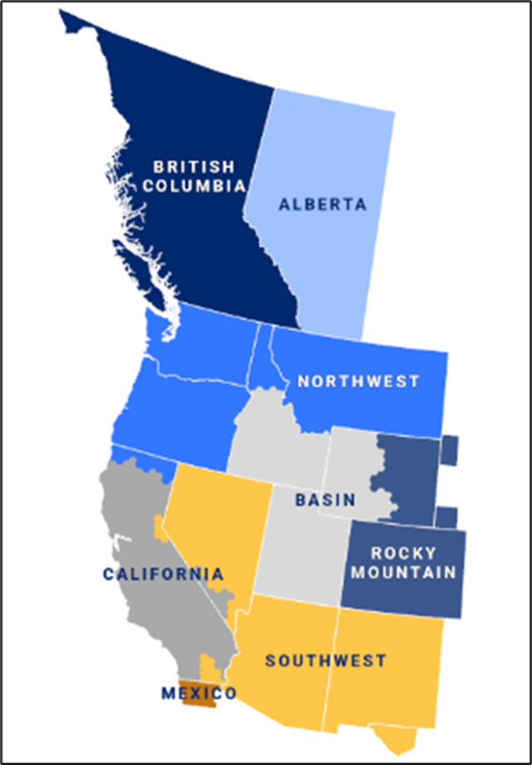
Demand Forecasts
Planned Additions
Planned Retirements
Resource Mix
Resource Scenarios
Load Scenarios
Subregional Results
Links to Material

Slide 3
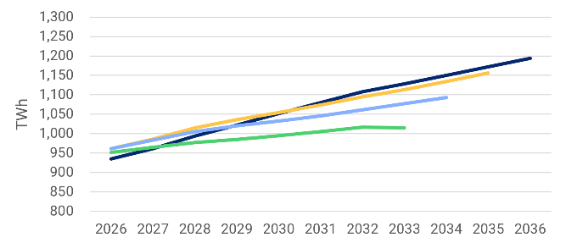
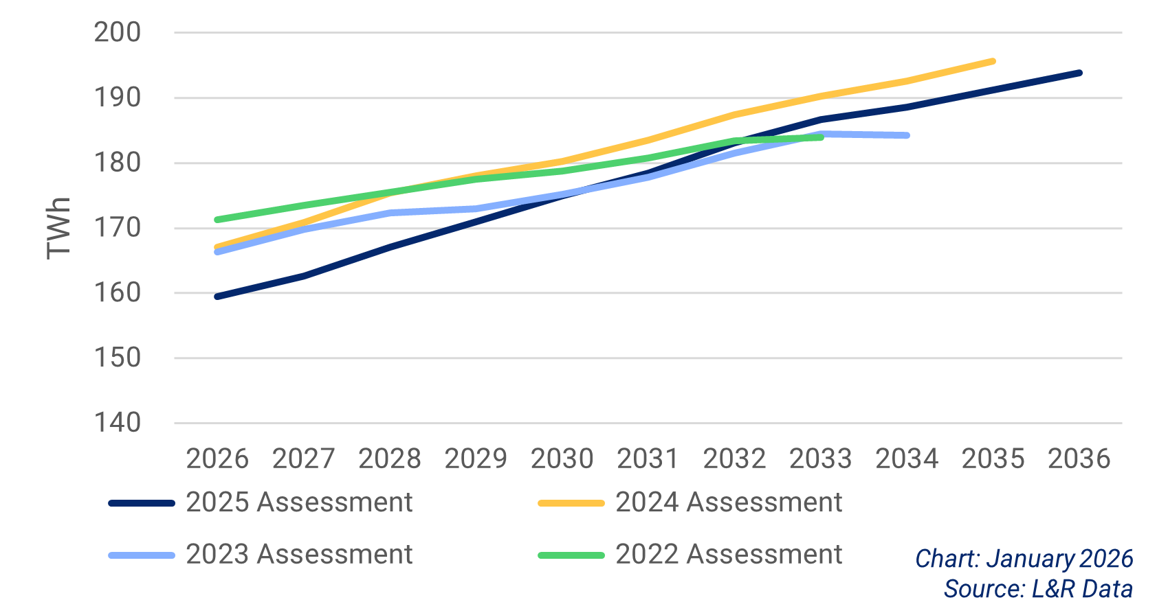
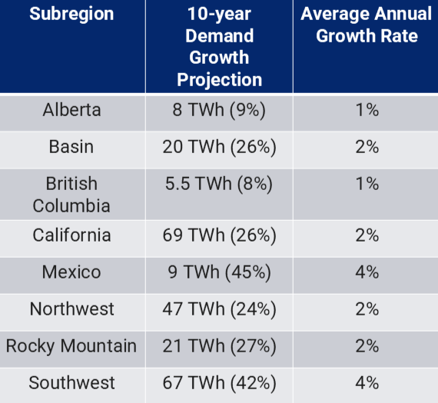
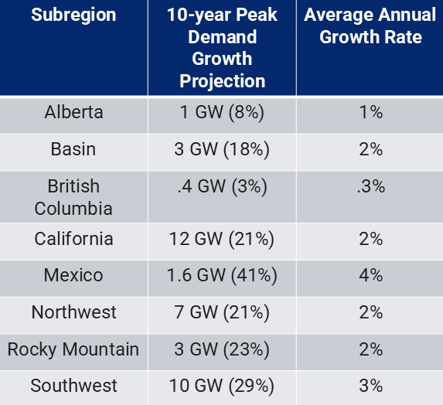
Demand Forecasts
Annual Demand Projections
Peak Demand Projections

Slide 4
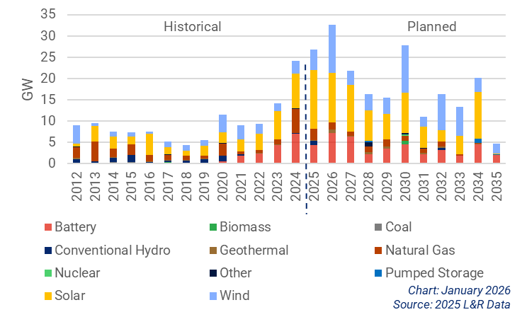
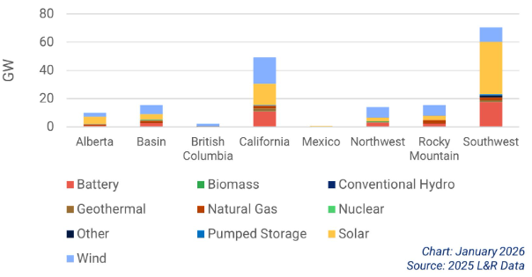
Planned Additions
Historical and Planned Additions
Planned Additions by Subregion
119 GW of resource additions are in California and the Southwest
15 GW of additions in Basin, the Northwest, and Rocky Mountain
13 GW of additions in Alberta, British Columbia, and Mexico
177 GW​ from 2026-2035
90% is inverter-based resources (battery, solar, wind)
70% are variable energy resources (solar & wind)

Slide 5
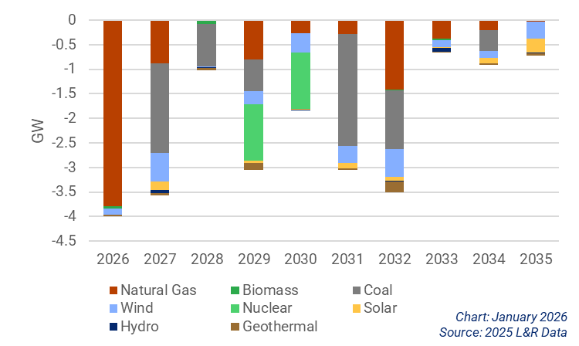
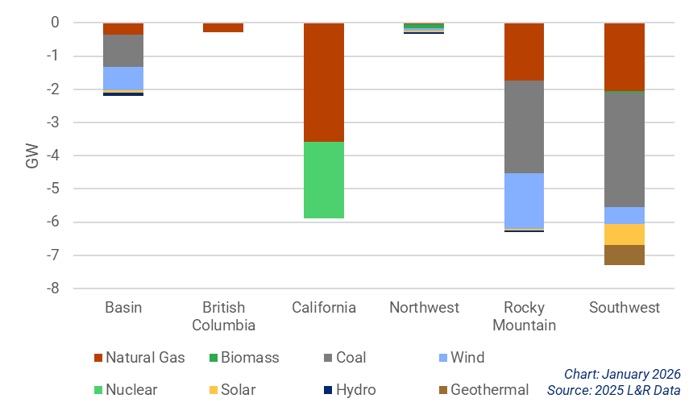
Planned Retirements
Planned Retirements
Planned Retirements by Subregion
22 GW​ from 2026–2035
80% is natural gas, coal, or nuclear
7 GW in the Southwest
6 GW in California and Rocky Mountain

Slide 6
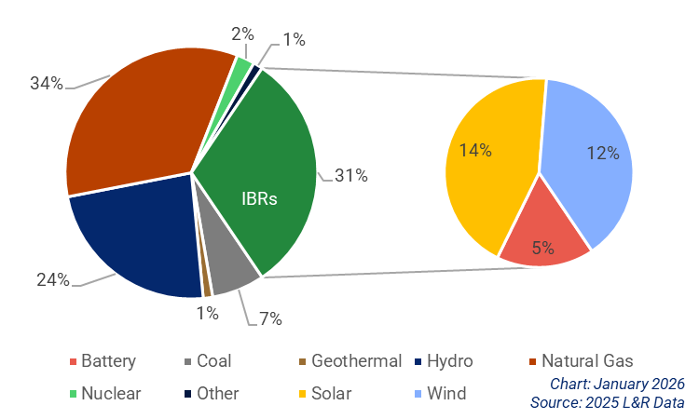
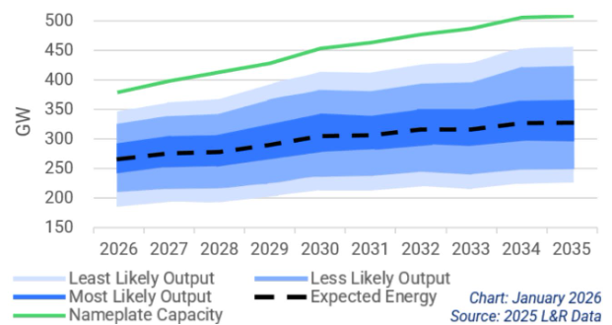
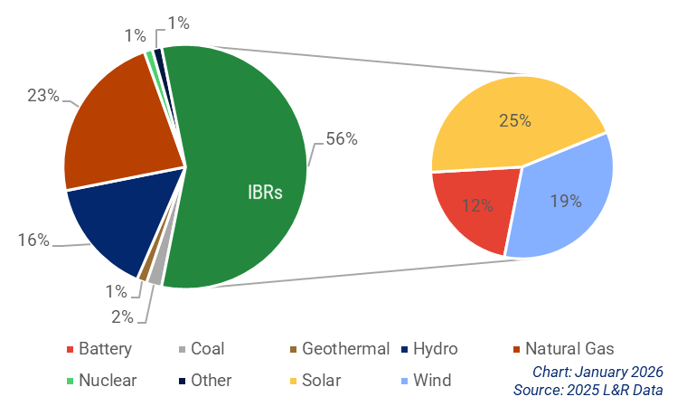
Resource Mix
Year-End 2024
Comparison of Nameplate Capacity to Available Energy
Projected Year-End 2035

Slide 7
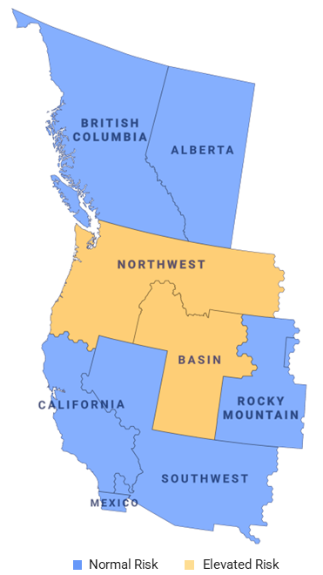
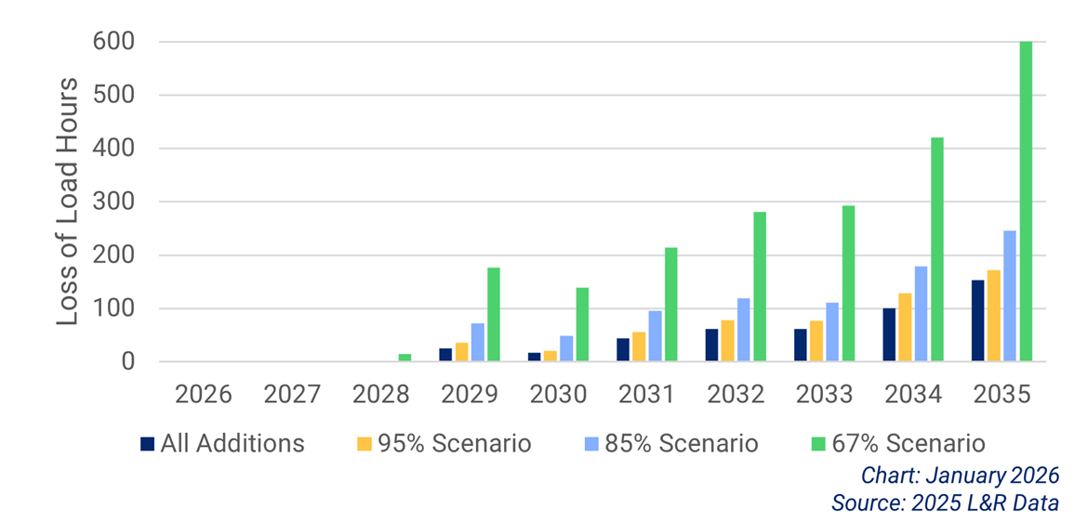
Resource Scenarios
Comparison of Resource Buildout Scenarios
Even with all planned resource additions, loss of load is encountered.

Slide 8
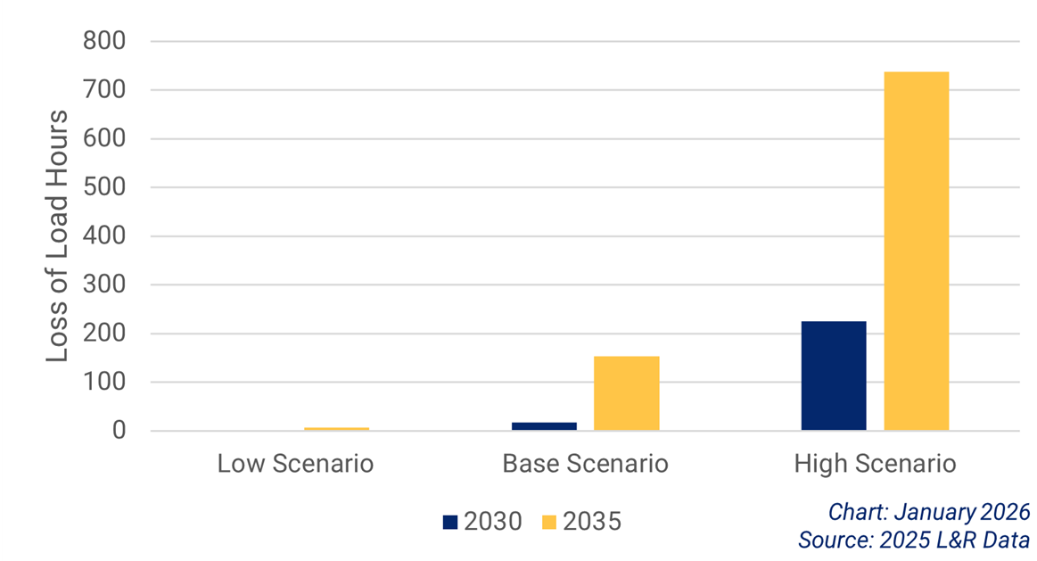
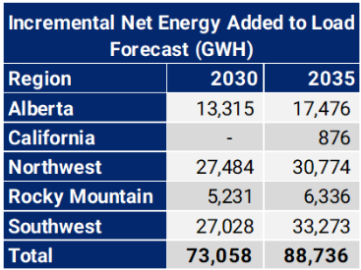
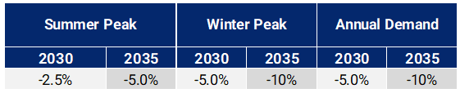
Load Scenarios (2030 and 2035)
Comparison of Load Scenarios
High Load Scenario
Low Load Scenario
Even with all planned resource additions and a reduction in demand, loss of load is encountered in the Northwest subregion.

Slide 9
Northwest
All Additions: 445 LOLH
95%: 525 LOLH
85%: 706 LOLH
67%: 1,294 LOLH
High Load: 218 LOLH (2030), 714 LOLH (2035)
Low Load: 1 LOLH (2030), 7 LOLH (2035)

Slide 10
Basin
All Additions: 18 LOLH
95%: 43 LOLH
85%: 163 LOLH
67%: 711 LOLH
High Load: 7 LOLH (2030), 24 LOLH (2035)

Slide 11
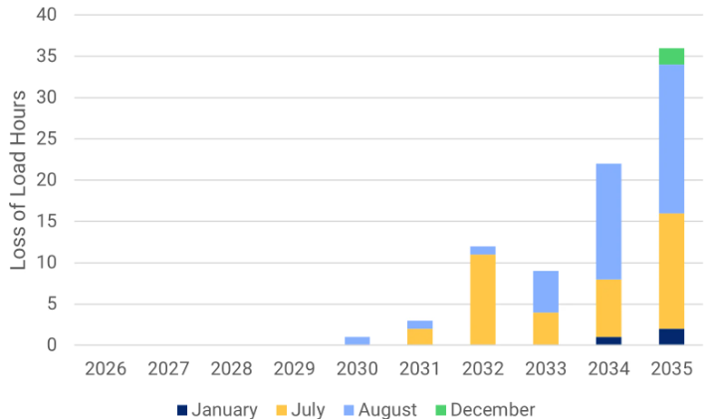
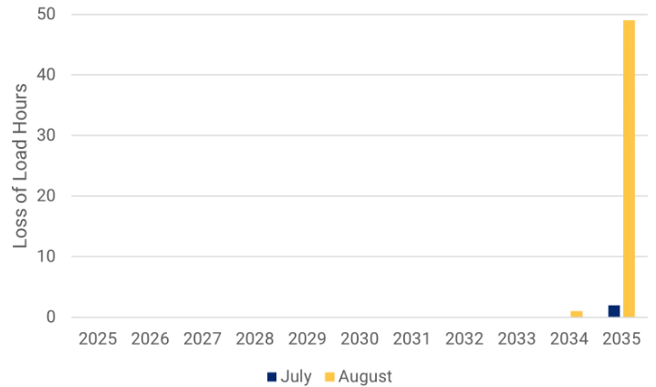
Other Subregions
Rocky Mountain 67% LOLHs by Month
Rocky Mountain
85% Scenario: 4 LOLH
67% Scenario: 83 LOLH
Mexico
67% Scenario: 52 LOLH
California
67% Scenario: 4 LOLH
Mexico 67% LOLHs by Month

Slide 12
Western Assessment Material
2025 Western Assessment of Resource Adequacy
Western Assessment Supplemental Material
Western Assessment of Resource Adequacy Modeling Approach
Western Assessment Glossary

