Slide 1
February 19, 2025
Large Load Industry Advisory Group
Matt Zapotocky
Senior Reliability Assessments Engineer

Slide 2
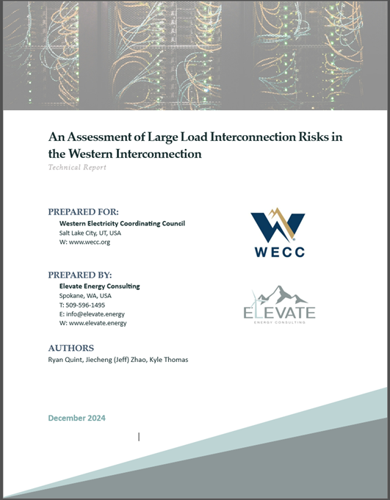
Large Load Industry Advisory Group
Meetings concluded as of January
Great Collaboration = Great Results:
  Report (published at the end of February)
  Educational materials
  Risk Register addition
  Loads & Resources Data Request improvements
  Future assessment(s)
Notes:
The Large Load Industry Advisory Group met from April 2024 through January of 2025. During these meetings, WECC members, industry advocates, and others from the Electric Reliability Organization (ERO) kindly volunteered to share their experiences with large loads including challenges they have encountered, recommendations to mitigate risks, and potential opportunities for cooperation with data center customers. The information shared during these meetings has been incorporated into a Large Load Report prepared by Elevate Energy. WECC is currently reviewing the report and is targeting a release to the public by the end of this February. In addition to the report itself, WECC plans to put out educational content with the format TBD and the target audience being policy makers and the public at large. This content will likely include modules on what large load types there are, how do they differ, system performance risk, and resource adequacy concerns and will likely begin to roll out in March. On top of this, discussions from this group have led to an effort to add Large Loads to WECC’s Risk Register, which as I understand it is currently in progress. Then lastly, we would like to begin planning potential assessments that involve large load related scenarios later this year. Input from the Large Load Industry Advisory Group has been invaluable in helping us identify large load characteristics and metrics we need for modeling efforts, and we have updated our Loads and Resources Data Request to capture those this year. This group was incredibly informative and helpful and re-affirmed my belief that great collaboration yields great results. Though the group has been discontinued for now to allow us to focus on the above shown efforts, there is a high likelihood we will still be reaching out to those who have participated for their expertise as we begin those assessment efforts.

Slide 3
Continued Engagement
Opportunities for continued engagement:
  NERC Large Load Task Force (LLTF)
  ERCOT Large Flexible Load Task Force (LFLTF)
  ESIG Large Load Task Force
  Future large load related efforts from WECC
Notes:
For those of you who were part of WECC’s Large Load Industry Advisory group, or if you are just interested in related efforts, the above shown task forces are active and you can stay plugged in by attending their meetings. Also, as mentioned, WECC will be performing additional efforts in the future centered around large loads, and we will surely need industry and member engagement in those, so please stay tuned there as well.

