Slide 1
April 1, 2025
Regional Entity and WECC Historical Data
Jillian Lessner
Adam Jensen

Slide 2
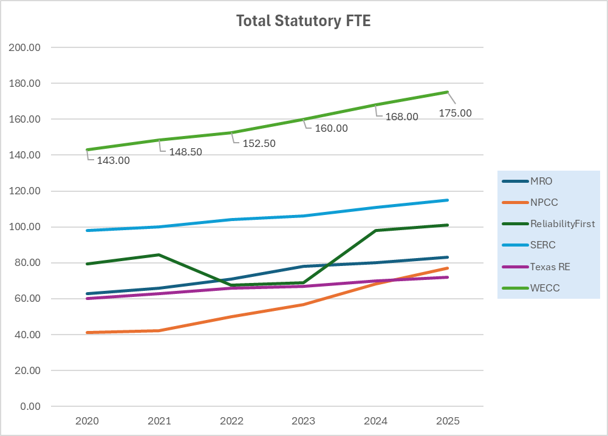
Statutory FTE by Region

Slide 3
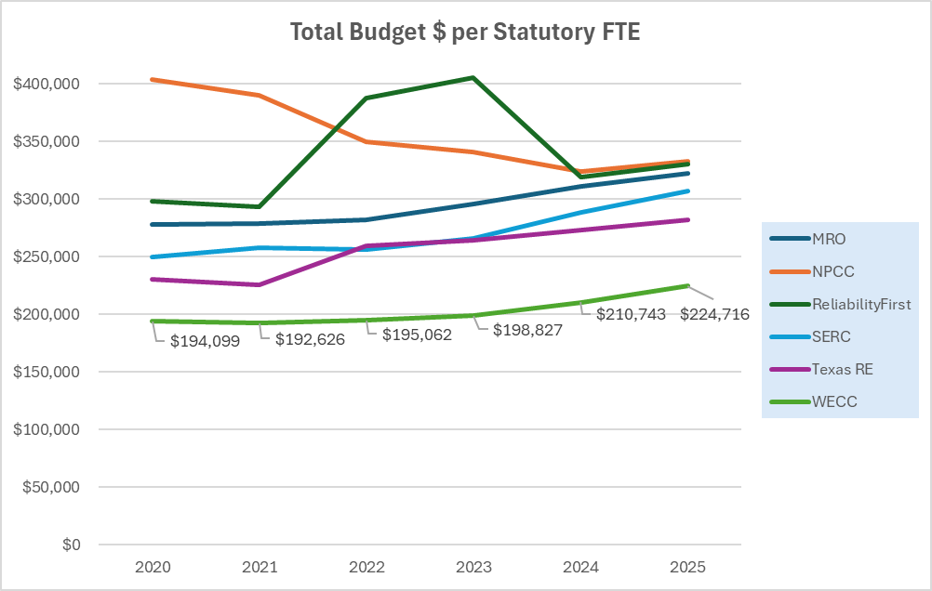
Total Budget per Statutory FTE

Slide 4
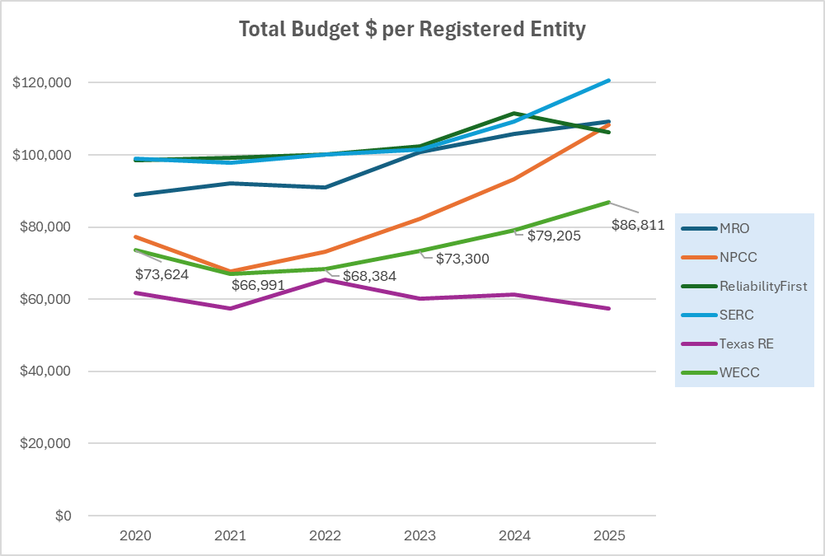
Total Budget per Registered Entity

Slide 5
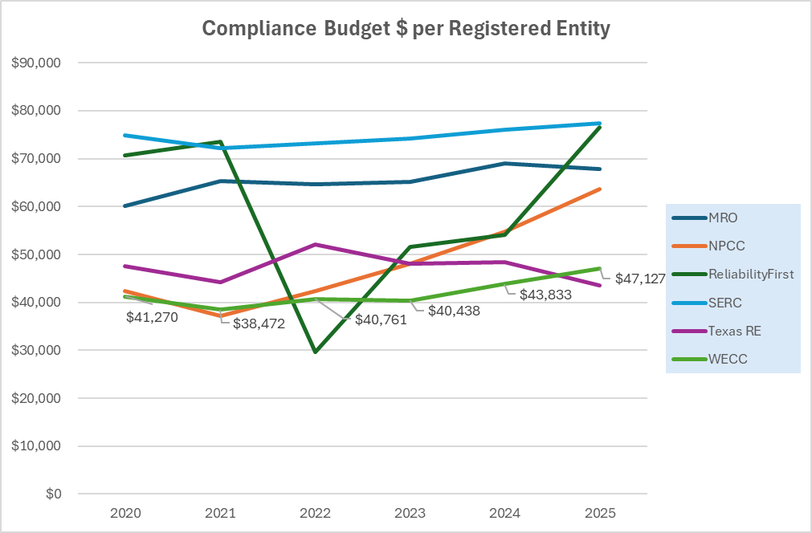
Compliance Budget per Registered Entity

Slide 6
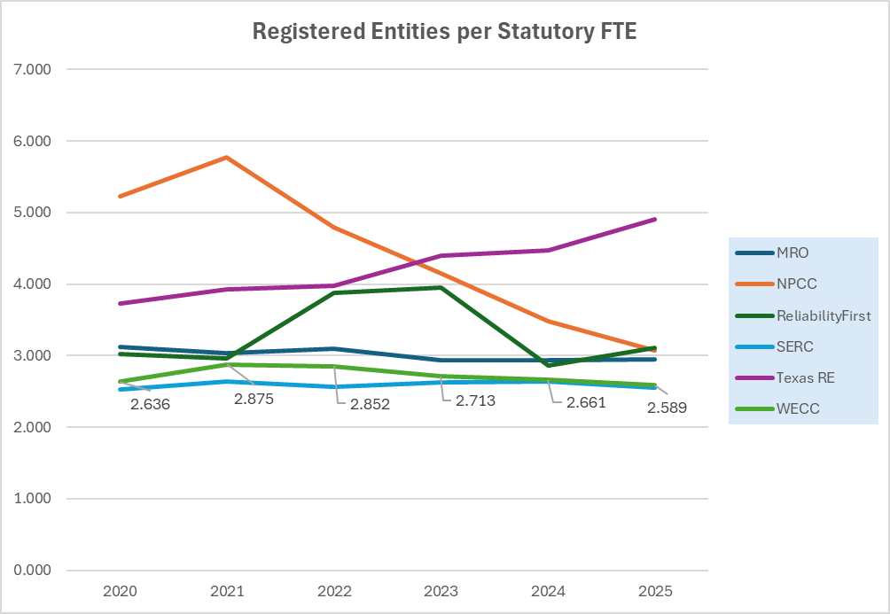
Registered Entities per Stat FTE

Slide 7
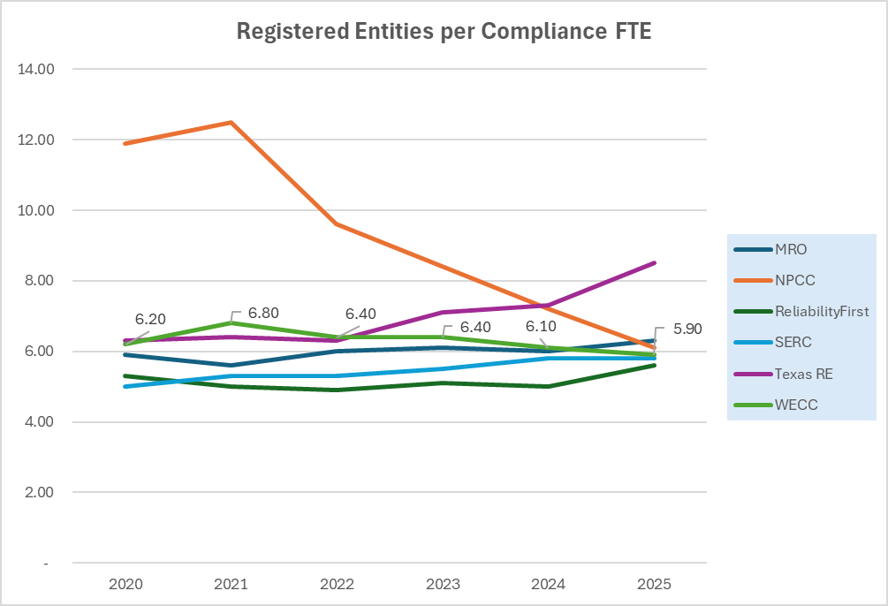
Registered Entities per Compliance FTE

Slide 8
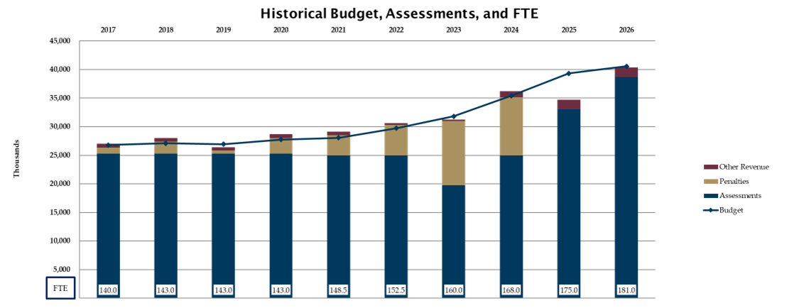

Historical Budget, Assessments, and FTE

