Slide 1
January 08, 2025
PCDS Meeting
Anuj Patil
WECC

Slide 2
Updated Time Series Profiles from NREL/PNNL
PNNL/NREL provided time series profiles for the new Hourly Resources in the 2034 ADS case.
Total 885 generator locations, 633 solar and 252 wind.
Resources used to collect the data
  Solar – National Solar Radiation Database (NSRDB) current dataset. Nominal solar irradiance of 4 km spatial resolution. Resource year used is 2018.
  U.S Wind – NOAA’s (National Oceanic and Atmospheric Administration) High Resolution Rapid Refresh (HRRR) dataset. Nominal wind speed of 3 km spatial resolution. Resource year used is 2018.
  Canada Wind – WIND (Wind Integration National Dataset) toolkit was used. Resource year used was 2013 since that is the latest year available in the toolkit.

Slide 3
Updated Time Series Profiles from NREL/PNNL
Wind Turbine Technology assumptions
Mapping that WECC has used to place the wind units in the appropriate groups:
  Group A (Turbine 2) – Generators with a DevStatus value of ‘Existing’ in the GeneratorList table.
  Group B (Turbine 2) – Generators with a DevStatus value of T1 or T2 in the GeneratorList table.
  Group C (Turbine 2) – Generators with a DevStatus value of T3 in the GeneratorList table.
​ | Group A (Existing)​ |  |  | Group B (2020-2030 4MW)​ |  |  | Group C (2030+ 6MW)​
​ | Turbine 1​ | Turbine 2​ | Turbine 3​ | Turbine 1​ | Turbine 2​ | Turbine 3​ | Turbine 1​ | Turbine 2​ | Turbine 3​
WS range​ | <7.5​ | 7.5-8​ | >8​ | <7​ | 7-8​ | >8​ | <7​ | 7-8​ | >8​
Turbine rating (MW)​ | 1.695​ | 1.791​ | 1.922​ | 4​ | 4​ | 4​ | 6​ | 6​ | 6​
Rotor diameter (m)​ | 97​ | 94​ | 92​ | 173​ | 160​ | 147​ | 196​ | 184​ | 170​
hub-height (m)​ | 80​ | 80​ | 80​ | 112​ | 105​ | 99​ | 120​ | 112​ | 105​
Specific power (W/m2)​ | 230​ | 260​ | 290​ | 170​ | 199​ | 236​ | 199​ | 226​ | 264​

Slide 4
Updated Time Series Profiles from NREL/PNNL
Few observations after working with the data:
  There are 117 Solar units that have a per unit hourly output multiplier of 0 for the whole year. Currently working with NREL and PNNL for some more clarifications on these.
  All the Solar units (apart from the 117 units above which have 0 per unit hourly output multiplier for the year) have a max per unit hourly output multiplier of 0.746. Pending some clarification from NREL/PNNL on whether these used to be unitized further or should be used as is.

Slide 5
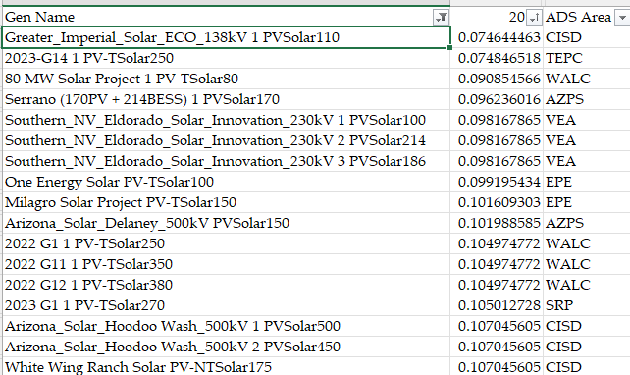
Updated Time Series Profiles from NREL/PNNL
Few solar units found in the Desert Southwest region with low average per unit hourly output multiplier for the year.

Slide 6
Updated Time Series Profiles from NREL/PNNL
Wind units with low average per unit hourly output multiplier for the year.
  Group A (Existing type)
  Group B (T1 and T2 units)
Gen Name | Turbine_B.2 | ADS Area | Tier | CommissioningYear
Wind_Peace_18 1 WTWind137.5 | 0.11354612 | BCHA | T2 - Future-Planned | #2028-11-01#
Wind_Peace_19 1 WTWind87.5 | 0.11354612 | BCHA | T2 - Future-Planned | #2028-11-01#
Wind_Peace_20 1 WTWind158.3333 | 0.085925571 | BCHA | T2 - Future-Planned | #2028-11-01#
Wind_Peace_28 1 WTWind150.0 | 0.077747032 | BCHA | T2 - Future-Planned | #2028-11-01#
Greater_Imperial_Wind_New Sub - Suncrest 1 WTWind200.0 | 0.116622489 | CISD | T2 - Future-Planned | #2030-05-01#
Greater_Imperial_Wind_New Sub - Suncrest 2 WTWind200.0 | 0.116622489 | CISD | T2 - Future-Planned | #2032-05-01#
Humboldt_Bay_Offshore_Wind_Humboldt 2 WSWind195.0 | 0.130886187 | PG&E | T2 - Future-Planned | #2033-05-01#
Sand Hill C 1 WTWind80.0 | 0.158050343 | CIPV | T1 - Under Construction | #2022-12-31#
Wi Eco 1 WTWind100.0 | 0.185794521 | WACM | T2 - Future-Planned | #1905-07-19#
Wi Eco 2 WTWind100.0 | 0.185794521 | WACM | T2 - Future-Planned | #1905-07-25#
Wi Wyo Wne WTWind200.0 | 0.18944258 | PNM | T2 - Future-Planned | #1905-07-20#

