Slide 1
January 21, 2025
PCDS Meeting
Jon Jensen
WECC

Slide 2
Status
What we’ve done
  1:1 mapping L&R/PCM to PF
  Non 1:1 benchmarked to L&R (Not to PF)
Walk through process
Reference PF on export for reactive info

Slide 3
Data Management
L&R primary source of supply
PF primary source for system topology (locations, IDs, etc.)
Create Data Management/Mapping Table
  EIA/L&R/PF/PCM (WECC edited)
  Original data from L&R, yes or no if filled/changed data

Slide 4
Building ADS PCM
Adding Gens to PCM
Reactive settings
  Reference PF (corresponding PF) “2034HS1_PCM_V’XX’” power flow
  Any extra gens from L&R will be in this modified PF
C-PAGE mapping

Slide 5
Placed Units
2034 ADS PCM matches the L&R, there is an “X” for placed units
Reasons
  No bus submitted in L&R
  L&R bus is not in 2034 topology
Placed units
    ≈2300 units “XX”
    Over 1,000 existing units “XX”
    6398 Total units in case

Slide 6
Approach
Updates
  Update shape names (won’t affect results)
  Modify the MatchID change case for corrections
  Compare 2034 ADS to 2032 ADS for locations/IDs
    Clean up IDs, change “XX” to “1,2,3” to match PF
  Clean up
    Regions/states/counties
    Etc.
Publish Case
Updates
  Continue to map ADS to PF
  Redistribute Generic Generation based on PF unmapped units
Publish Case

Slide 7
Example
For 2032 ADS Glen Canyon was submitted on buses 79150, 79151, 79152, 79153
For 2034 ADS Glen Canyon was submitted on buses 79150, 79151, 79152, 79153 (Busses are not in 2034 ADS)
  We placed them using our placement tool initially on 14072, 14073, 14078, 14079 (Moenkopi, Eldorado, Navajo)
  Later corrected them to busses 19788, 19789, 19790, 19791 (Glen Canyon Busses)

Slide 8
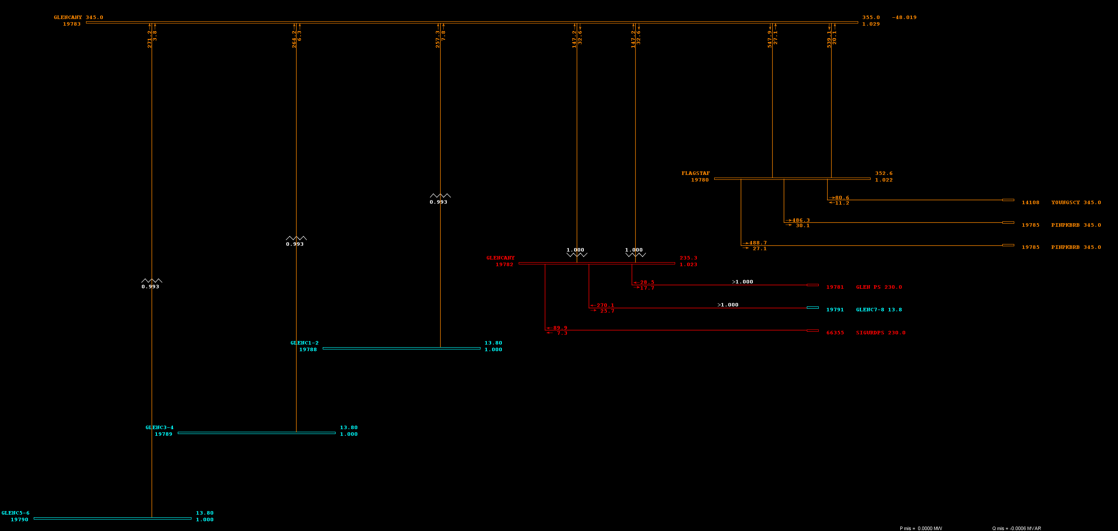
2034 ADS

Slide 9
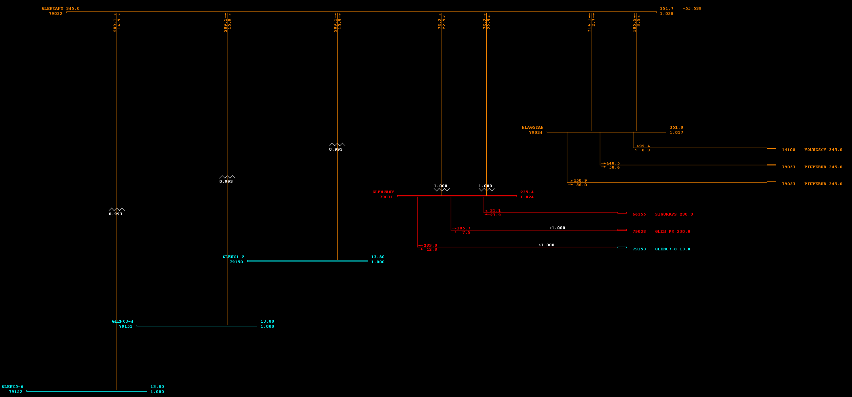
2032 ADS

