Slide 1
January 15, 2025
PCDS Meeting
Jon Jensen
WECC

Slide 2
Latest Version
2034_ADS_PCM_V2(2024LnR)_V2.0_LivingCase_1-10-2025
  Posted on PCDS Team Site with Change Files

Slide 3
Updates since 12-13 case
PDCI_MaintenanceUpdate.mdb
Slate_Humbolt_BottleRock_andDispatchPrice.mdb
DataSanityCleanUp_Order2.mdb
Diff_Kemano Hydro BC.mdb
Diff-Fuels and Hydro Cleanup.mdb
Diff-Thermal Heat Rate Updates.mdb
Flatiron3.mdb-Check operation of Flatiron3 (Is operating as PS)
GenericLM2500.mdb
GenListMinorUpdates_Order1.mdb
MatchIDs_Diff.mdb
Cleanup_Order3.mdb

Slide 4
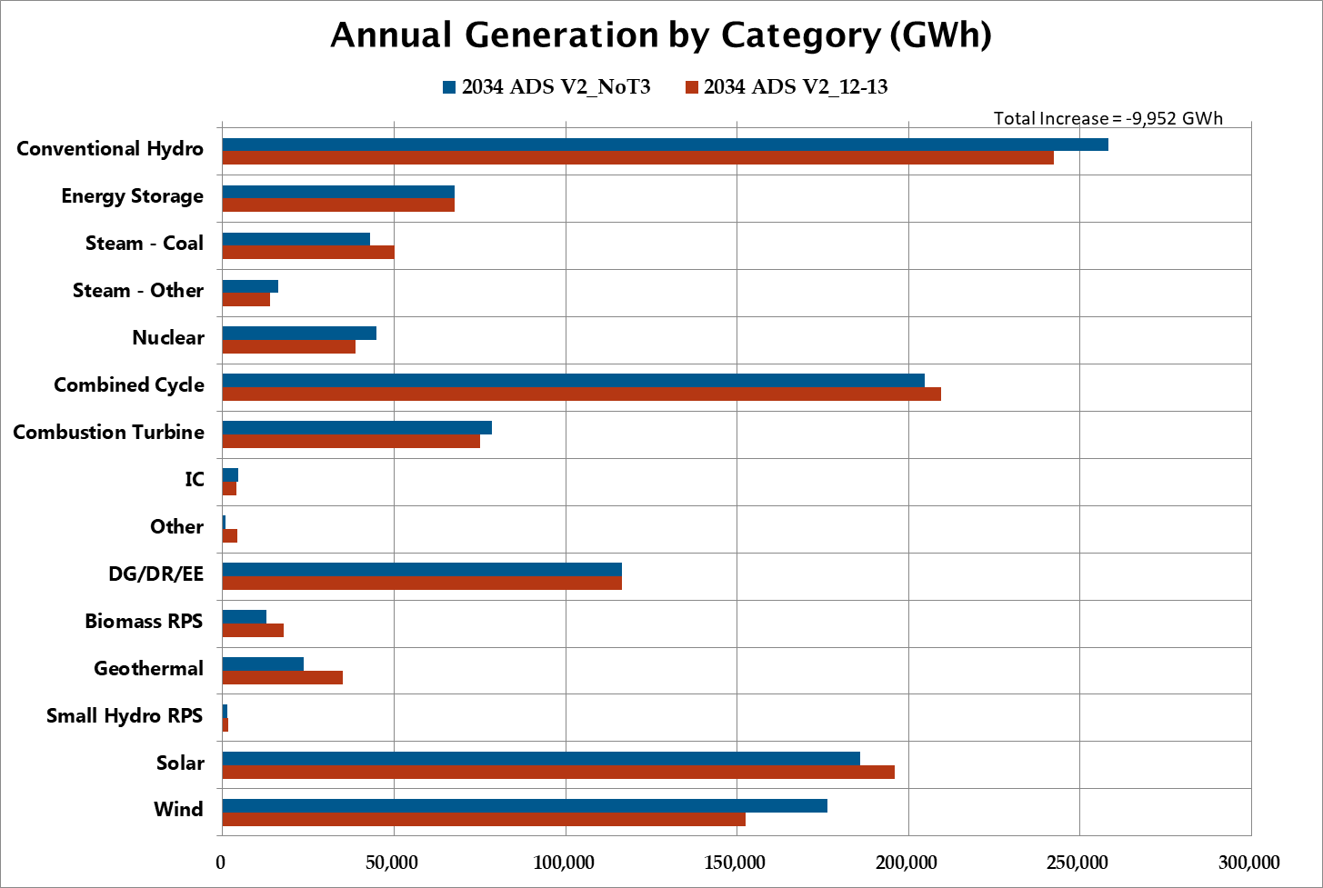

Annual Generation

Slide 5
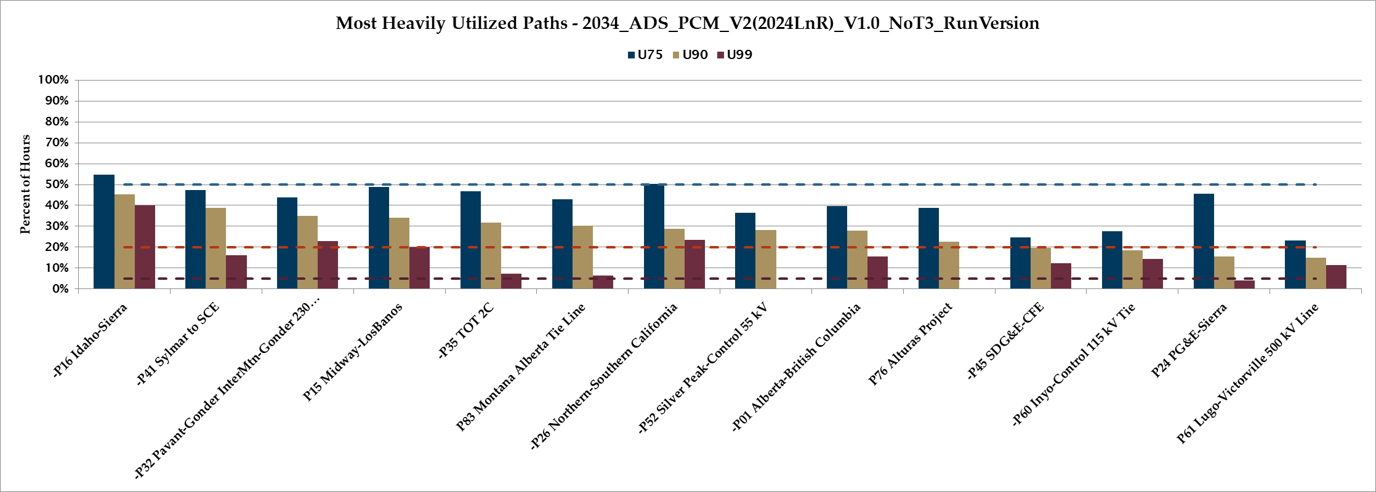
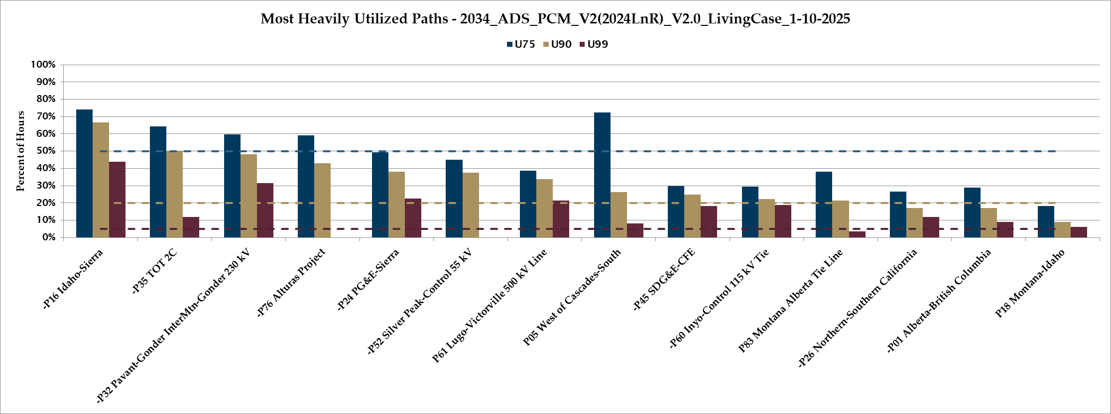

Slide 6
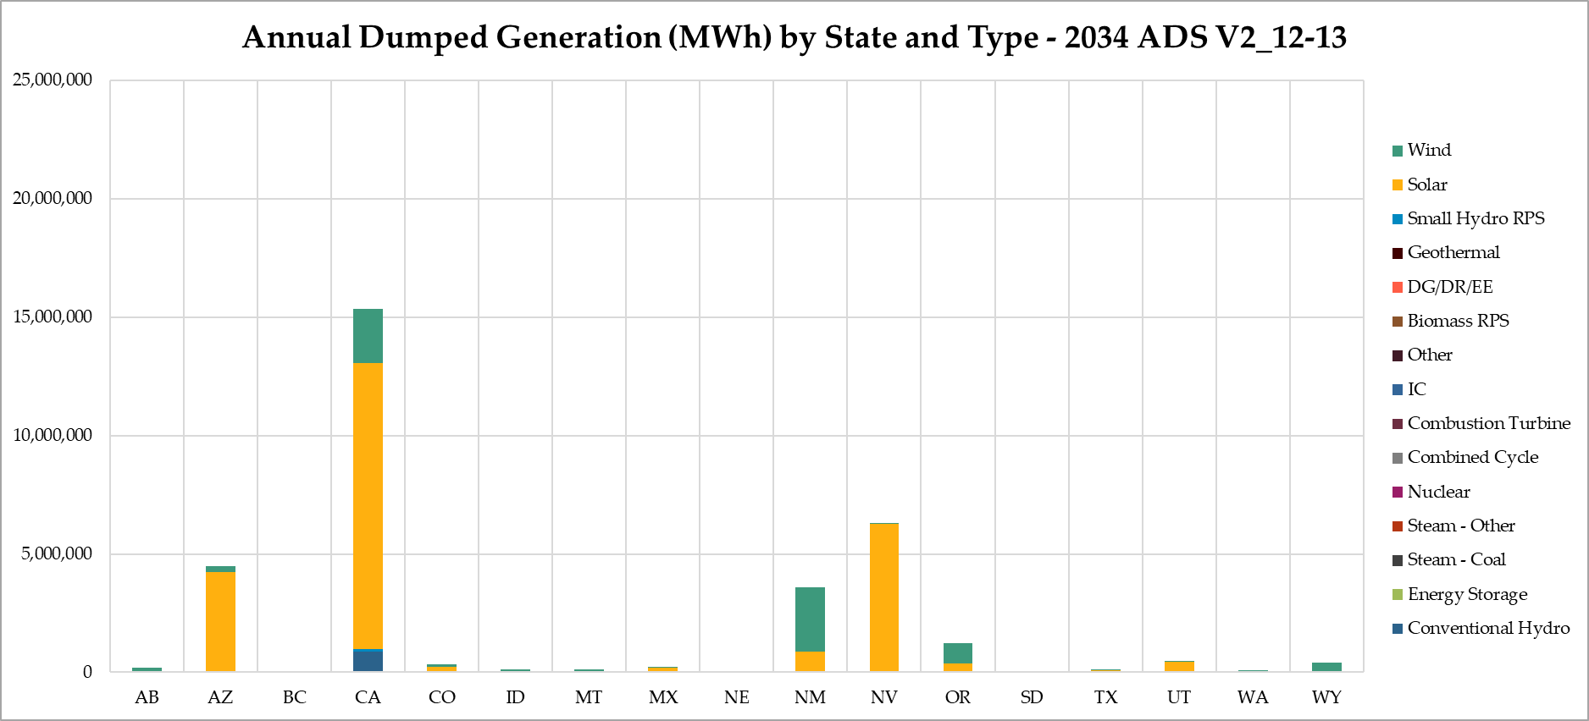
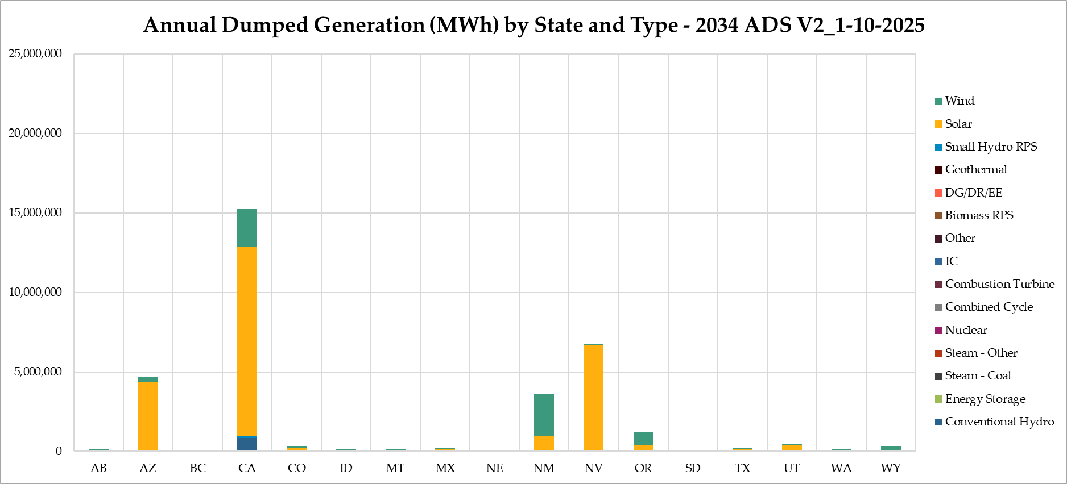
Dumped Generation

Slide 7
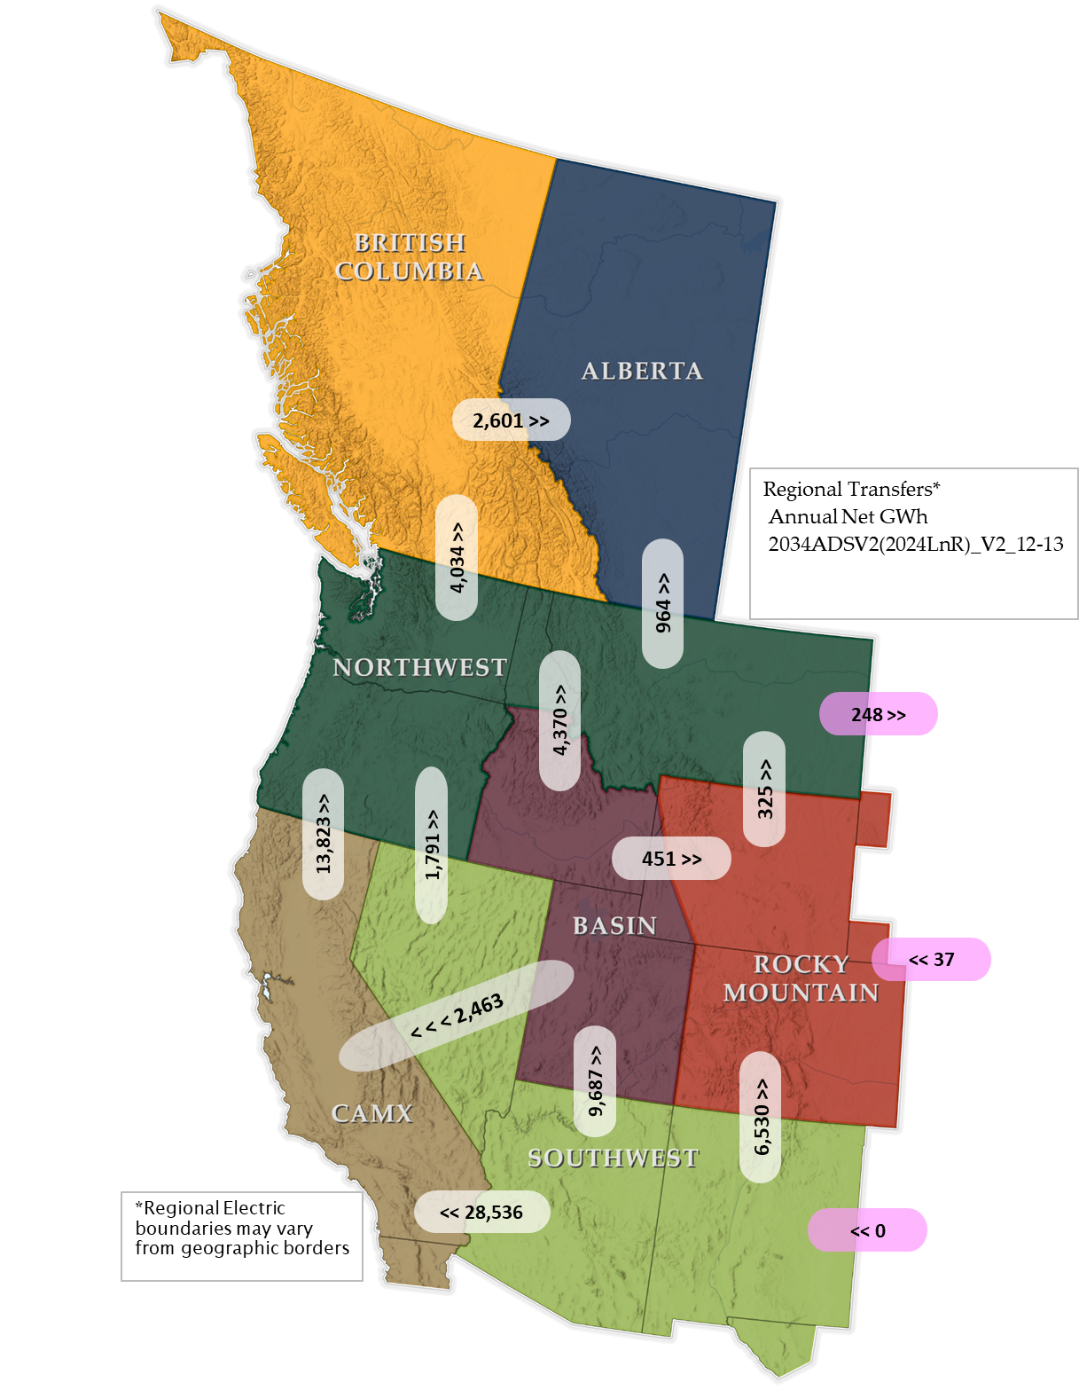

Regional Transfers

Slide 8
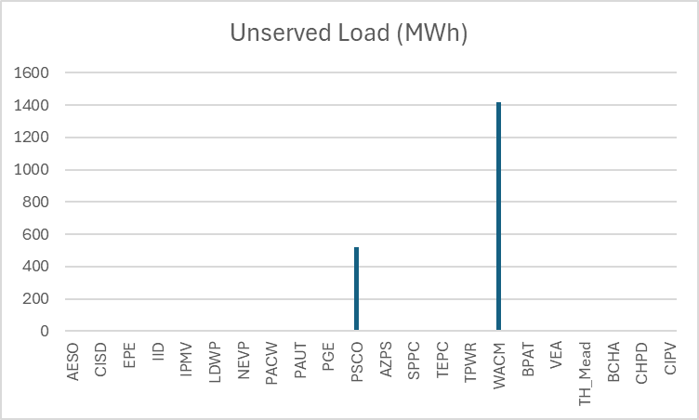
Unserved Load

Slide 9
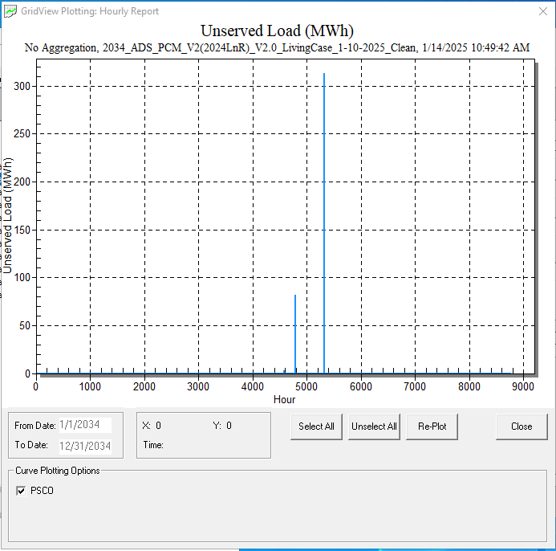
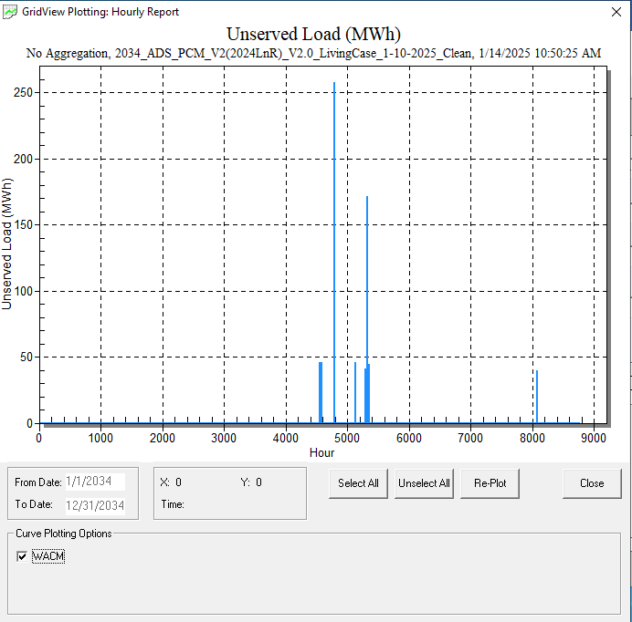
Unserved Load

Slide 10
Updates For Next Run
Update shape names (won’t affect results)
Redistribute Generic Generation based on PF unmapped units
Clean up
  Regions/states/counties
  Etc.

