Slide 1
June 26, 2024
PCDS Meeting
Jon Jensen
WECC

Slide 2
2034 ADS V2 Draft Run VH3
GV 10.3.62
No MIO or Lookahead
Distributed into two runs
About 10.5-hour run time

Slide 3
Unserved Load
Unserved load
WAUW 153,854 MW

Slide 4
Annual Energy

Slide 5
Annual Energy

Slide 6
Spillage
V1=10,031 GWh
V2=125,202 GWh

Slide 7
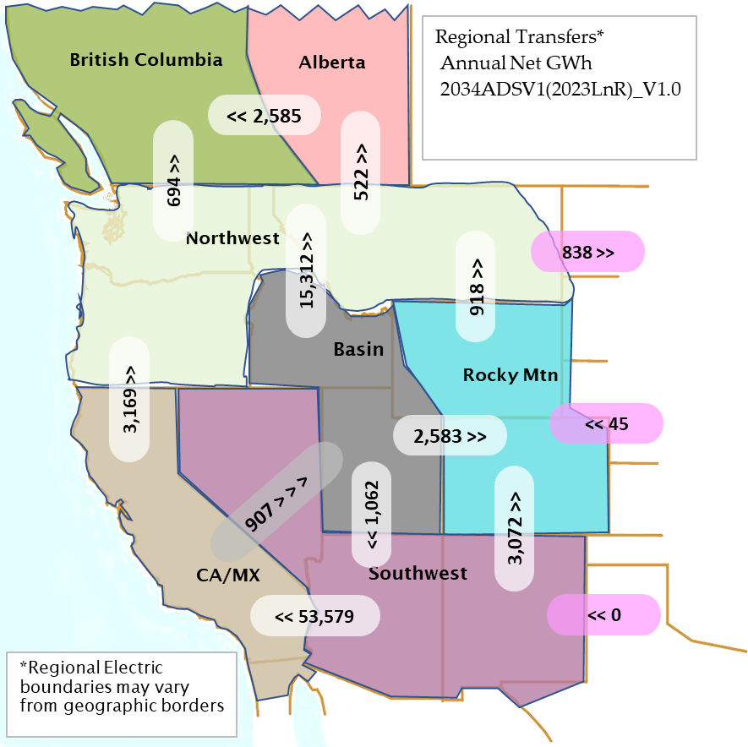
Regional Net Transfers

Slide 8
Net Annual Flow
N>S

Slide 9
