Slide 1
Wildlife Data Update: WAFWA CHAT
Environmental Data Work Group
April 7, 2017
Nate Wagoner, ICF
Dan Moreno, ICF

Slide 2
Presentation Overview
  Status of CHAT data coordination
  Review of a test application of CHAT integration
  Consider approval of integration approach

Slide 3
Wildlife Data Update
  EDWG is replacing its wildlife data source in the Environmental Risk Layer:
    Using Crucial Habitat Assessment Tool (CHAT) data from the Western Association of Fish and Wildlife Agencies (WAFWA)
    CHAT-to-Environmental Risk Layer crosswalk approach approved by WAFWA

Slide 4
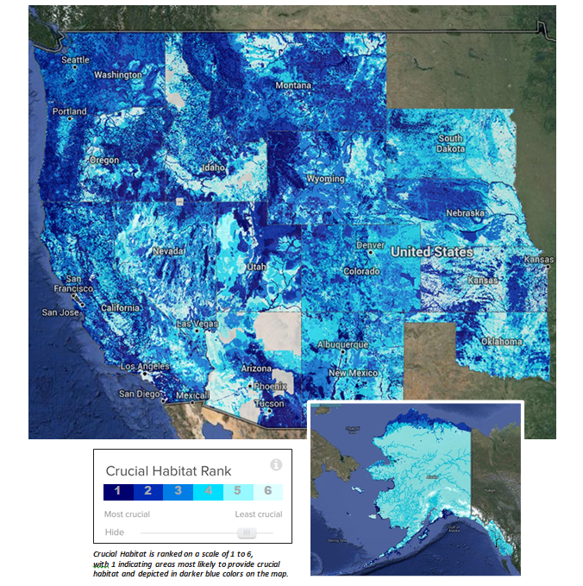
CHAT Crucial Habitat Data

Slide 5
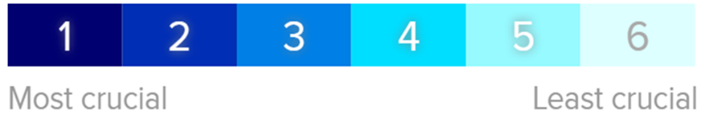
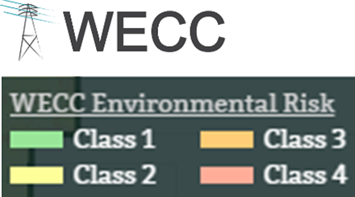
CHAT Crucial Habitat/WECC Risk Score Crosswalk
CHAT Crucial Habitat Rank | WECC Environmental Risk Score
1 – Most Crucial | 3 – High Risk
2 | 3 – High Risk
3 | 2 – Moderate Risk
4 | NA
5 | NA
6 – Least Crucial | NA

Slide 6
Remaining Question
Are all Crucial Habitat Rank “Data Input Layers” relevant to transmission planners?
In other words, should the Crucial Habitat Rank data always be used in the Environmental Risk Layer, or should EDWG “turn it off” when it’s describing a wildlife habitat feature that may not affect transmission planning and siting?

Slide 7
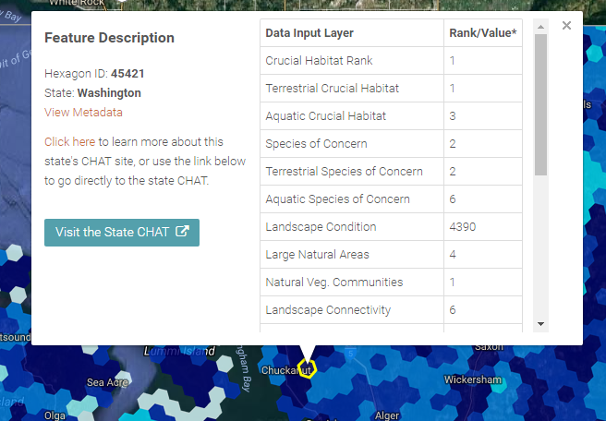
WAFWA CHAT: Crucial Habitat Data Makeup

Slide 8
WAFWA CHAT Integration
    January 2017 – EDWG Meeting recommended Aquatic Data Input Layers potentially not relevant for Risk Score
    February 2017 – EDWG/WAFWA agreed to test removal of Aquatic Habitat Data Input Layers for CHAT for 3 states.
    March 2017 – Tested removal for Montana, Nevada, Washington. (Montana data were found to be unavailable)
    Today – Review test results for NV/WA; Approve approach for CHAT incorporation into Environmental Risk Layer

Slide 9
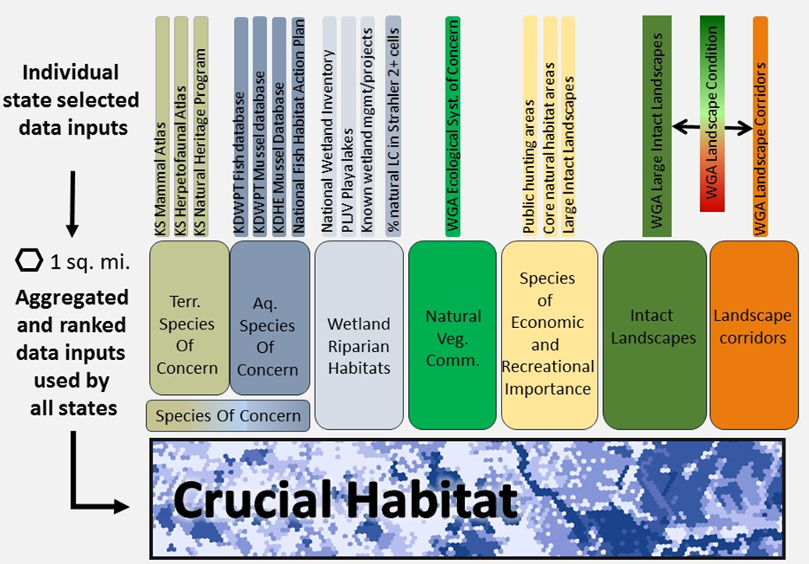
WAFWA CHAT: What is “Aquatic Data”?

Slide 10
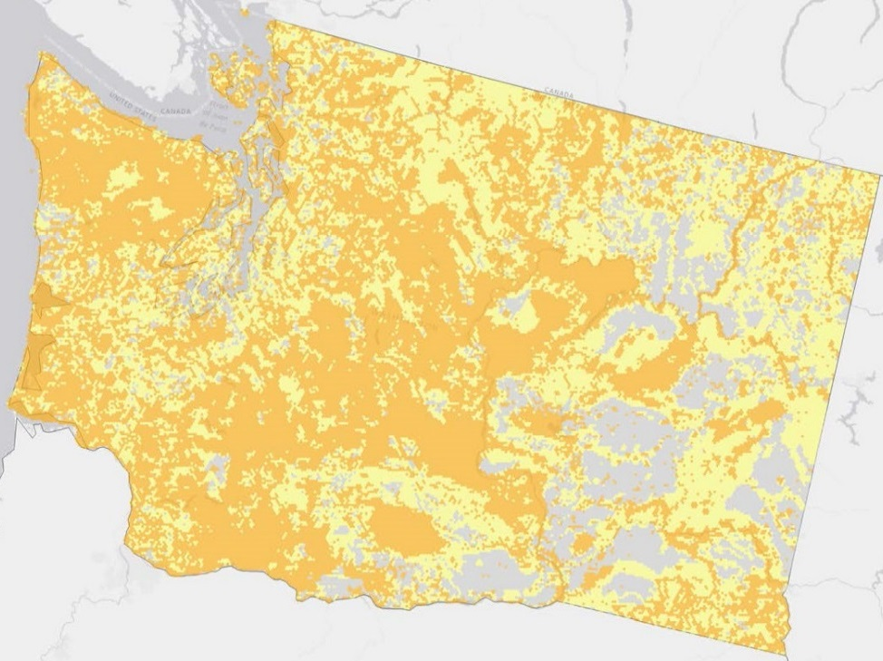
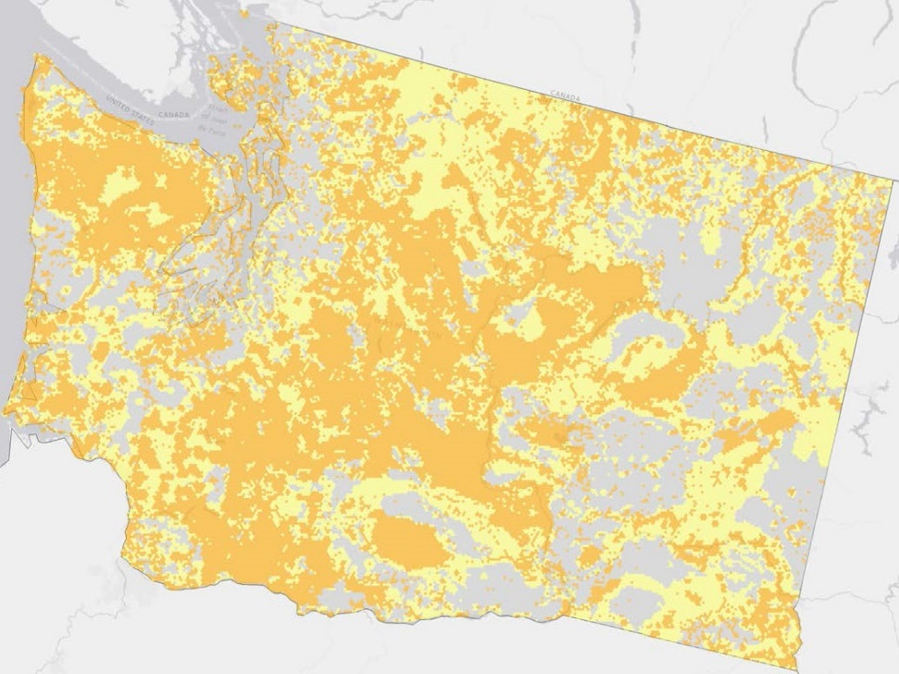
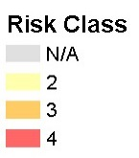
Test Case – Washington CHAT
Risk Score from Original CHAT
Risk Score Aquatic CHAT Removed

Slide 11
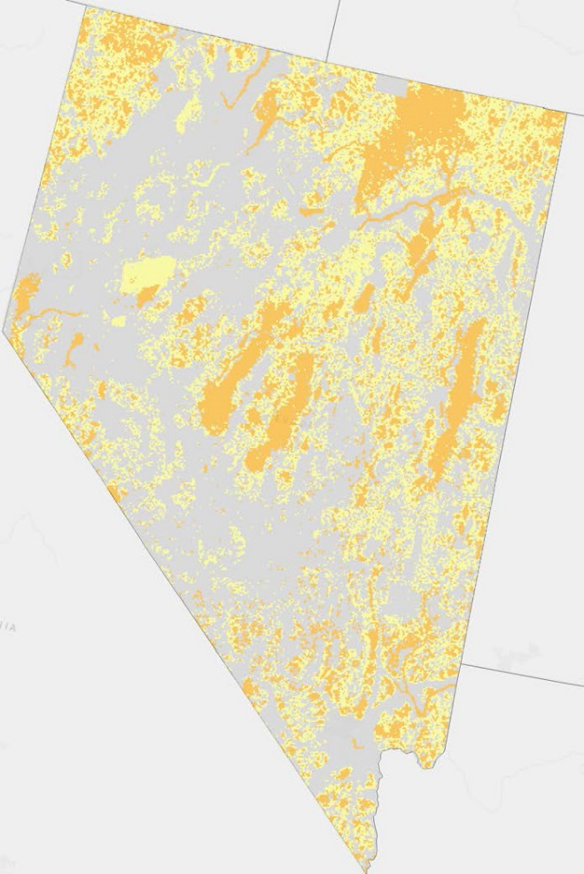
Test Case – Nevada CHAT
Risk Score from Original CHAT
Risk Score Aquatic CHAT Removed

Slide 12
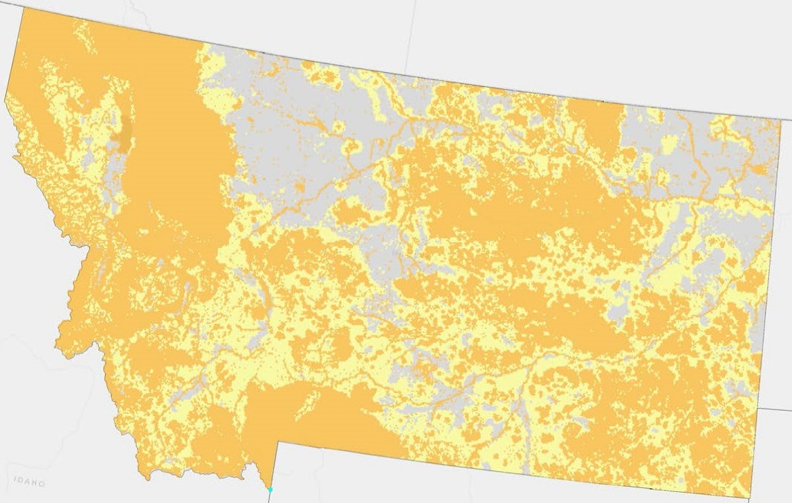
Test Case – Montana CHAT

Slide 13
CHAT to Environmental Risk Score Conversion
Washington Test Application | Original CHAT | CHAT with Aquatic Removed
Env Risk Score 2 | 25,321 sq mi (36% state) | 22,139 sq mi (32% state)
Env Risk Score 3 | 33,863 sq mi (49% state) | 29,433 sq mi (42% state)
Nevada Test Application | Original CHAT | CHAT with Aquatic Removed
Env Risk Score 2 | 30,000 sq mi (27% state) | 29,994 sq mi (27% state)
Env Risk Score 3 | 20,365 sq mi (18% state) | 20,371 sq mi (18% state)
Montana Test Application | Original CHAT | CHAT with Aquatic Removed
Env Risk Score 2 | 42,897 sq mi (29% state) | N/A
Env Risk Score 3 | 77,979 sq mi (53% state) | N/A

Slide 14
EDWG Decision Point
How should the 2017 Environmental Risk Layer incorporate CHAT Crucial Habitat Rank?:
Remove Aquatic Habitat Data (where possible) from Crucial Habitat Rank?
  -or-
Use unedited CHAT Crucial Habitat Rank; reevaluate Aquatic Habitat Data on publication of next version of CHAT

Slide 15
CHAT Integration Next Steps
Replace wildlife data in the existing EDWG in the Environmental Risk Layer with the Crucial Habitat Rank layer.
Data to be replaced
NatureServe Data
Individual State CHAT data from California, Montana and Washington Game and Fish Departments
State-identified Big Game Crucial Seasonal Habitats (e.g., Crucial Winter Range)
State-identified Big Game Migration Corridors

Slide 16
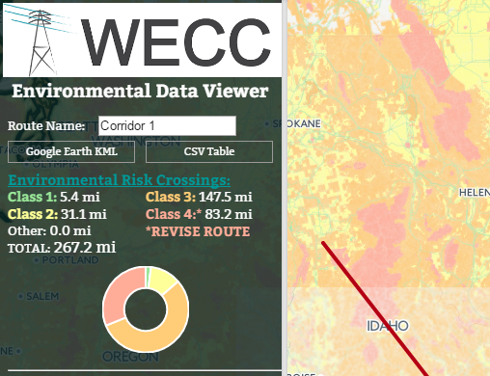
CHAT Integration Next Steps (cont)
Revise the Environmental Risk Layer and/or Data Viewer to report the full score from CHAT:
Not dependent on if CHAT affected the Environment Risk Score (was “on”).
Display miles of each CHAT Value crossed
Presented for informational purposes only

Slide 17

CHAT Integration Next Steps (cont)
Work with WAFWA on a Disclaimer for publication with the Data Viewer:
Describes need for project proponents to consult with the state agencies
Links to WAFWA CHAT website

Slide 18
Additional Background Data

Slide 19
Current Environmental Risk Scores
Test States
 | Montana | Nevada | Washington
Risk Score 1 | 6,384 sq mi (4% state) | 5,387 sq mi (5% state) | 5,818 sq mi (9% state)
Risk Score 2 | 48,427 sq mi (32% state) | 55,081 sq mi (48% state) | 35,028 sq mi (52% state)
Risk Score 3 | 82,818 sq mi (55% state) | 39,828 sq mi (35% state) | 19,153 sq mi (28% state)
Risk Score 4 | 12,262 sq mi (8% state) | 13,880 sq mi (12% state) | 7,696 sq mi (11% state)

Slide 20
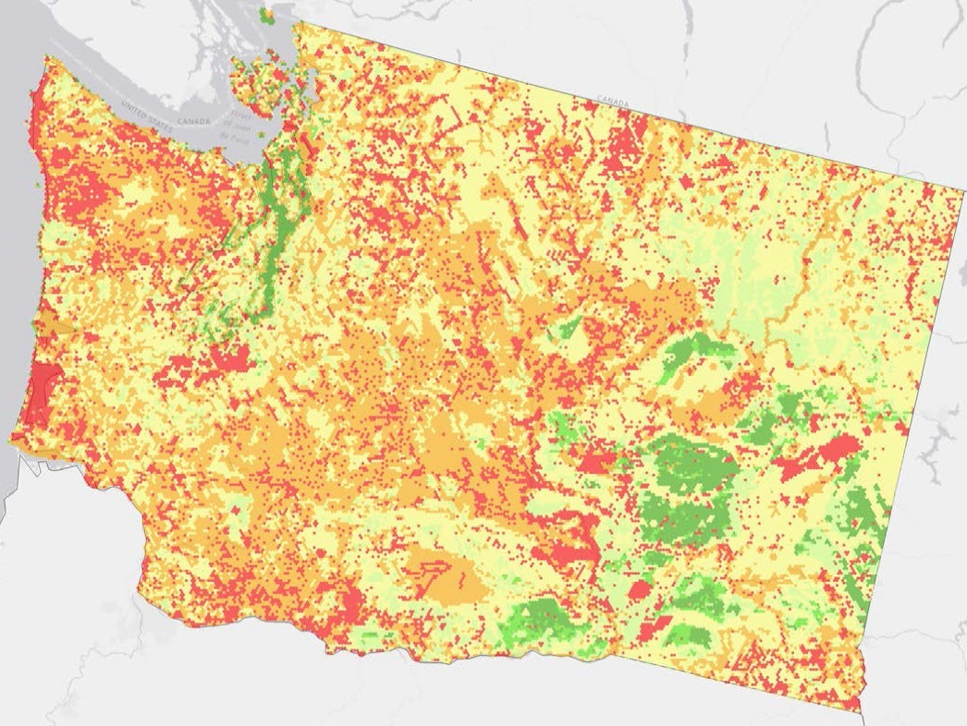
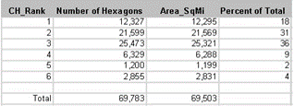
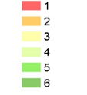
Test Case – Original CHAT Score

Slide 21
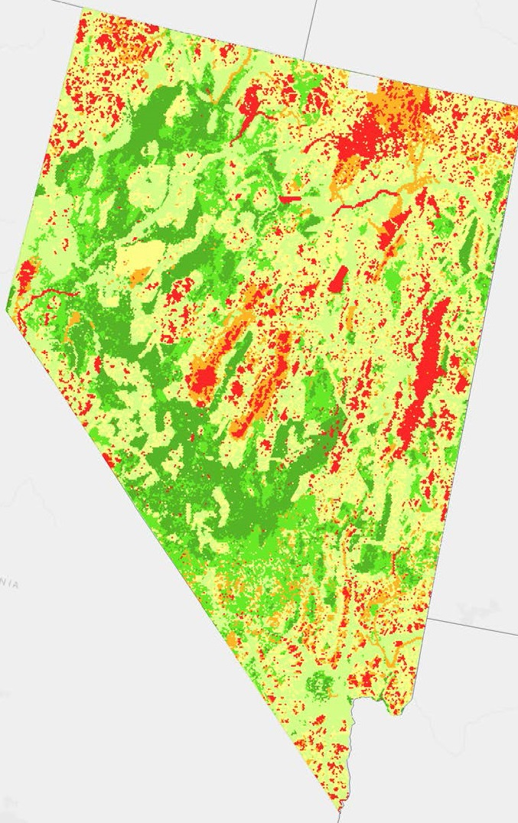
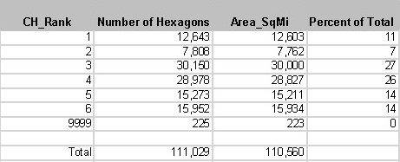
Test Case – Original CHAT Score

