Slide 1
Environmental and Cultural Data Products
Environmental Data Work Group
July 22, 2016
Nathan Wagoner, ICF
Dan Moreno, ICF

Slide 2
Presentation Overview
  Cultural Data
  Cultural Data Viewer Approval
  Outreach Update
  EDWG Stakeholder Survey Results
  Environmental Data Set Update
  Overview of update and QA process
  Approval of recommendations/next steps

Slide 3
EDWG Cultural Data

Slide 4
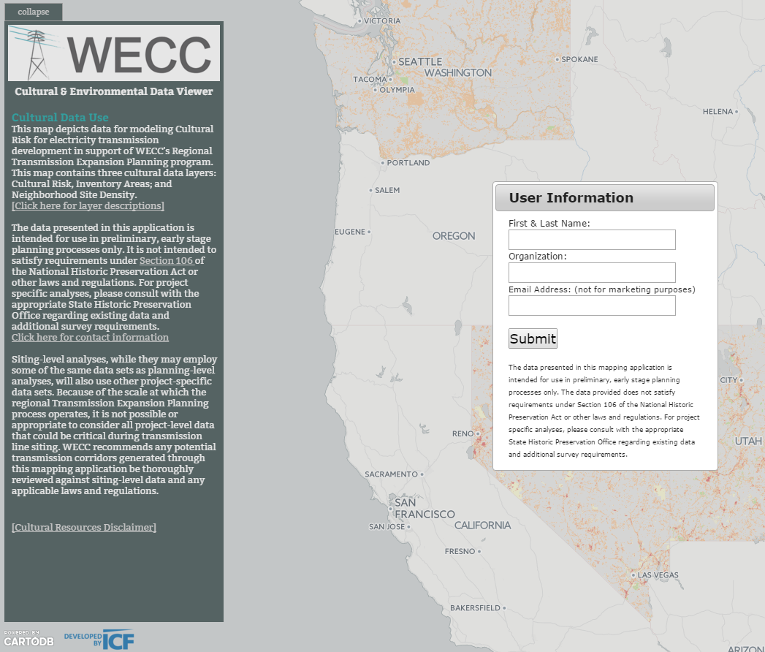
EDWG Cultural Data
  Cultural Data Viewer
  Demo Final Viewer
  Decision Point: Release Cultural Data Viewer?
  Cultural Data Updates:
  Status of California and Oregon outreach
  Arizona data now in process!

Slide 5
Environmental Data Work Group Stakeholder Input Survey and Beta Test

Slide 6
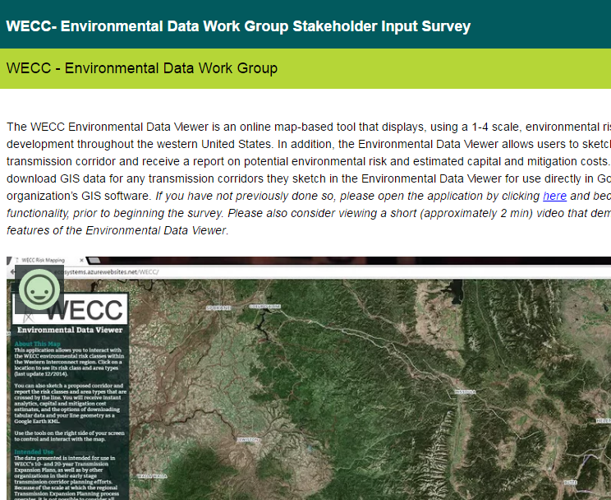
EDWG Survey Input
Completed Beta Test & EDWG Survey June 2016
  Beta Test – no reported functionality issues with the Data Viewer
  EDWG Survey – data suggestions and potential upgrades to Data Viewer

Slide 7
EDWG Survey: Additional Data Layers
Which additional map data layers would be most useful to you in performing your work?
Potential Data | Rating Average
Existing transmission lines | 4.60
Existing power plants and substations | 4.50
Threatened and Endangered species occurrences | 4.40
Visual resources or visual sensitivity | 3.92
Cultural (e.g., archaeological and historic) resources | 3.75
Water bodies and courses | 3.50
Hazards | 3.50
1 Low Importance/ 5 Highly Important

Slide 8
EDWG Survey: Additional Data Layers (CONT)
Which additional map data layers would be most useful to you in performing your work?
Potential Data | Rating Average
Slope terrain | 3.40
Vegetation | 3.20
Raptor habitat and nest locations | 3.08
Federal or state agency existing right-of-way agreements and easements | 2.83
Census/demographics | 2.36
Paleontological (fossil) resources | 2.00
Tribal data | 1.00
1 Low Importance/ 5 Highly Important

Slide 9
EDWG Survey: Additional Requested Layers
Existing energy infrastructure (e.g., pipelines, well pads)
Greater Sage-Grouse Priority/General habitat and leks
Viewshed issues (sensitive viewsheds such as parks and scenic areas)
Population density data (not census data)/residential zones/growth boundary zones
Airports
Visual Resource Management Data (BLM/US Forest Service)
Land Ownership and Land Use
Archaeological sensitivity zones (Predictive Modeling)
Crucial wildlife habitat data (State Fish and Wildlife)
Designated endangered species critical habitat
Restricted areas due to FAA (beyond DOD lands)
Military test and training areas

Slide 10
EDWG Survey: Desire for New Features
How important to you is the following NEW POTENTIAL functionality?
Potential Function | Rating Average
Change voltage type and class (AC/DC) against which capital cost is calculated. | 4.33
Pick two end points and have the system draw (optimize for) the least capital (or mitigation cost) route. | 4.08
Pick two end points and have the system draw (optimize for) the lowest environmental risk route. | 3.92
Sketch a line and have the system create a potential "corridor" | 3.78
Upload other data layers (e.g., survey locations, energy facilities) and have them appear in the online map. | 3.67
1 Low Importance/ 5 Highly Important

Slide 11
EDWG Survey: Desire for New Features
How important to you is the following NEW POTENTIAL functionality?
Potential Data | Rating Average
Report the risk classes and area types that occur within the buffer zone described above. | 3.56
"Redline" a map with comments and collaborate with others within my organization in a secure environment. | 3.56
Calculate mitigation costs from a sketched transmission line. | 3.50
Upload my organization's transmission line data and have them appear in the online map. | 3.42
1 Low Importance/ 5 Highly Important

Slide 12

EDWG Survey: Decision Points
Does the EDWG recommend WECC consider adding new Data Sets or Data Viewer Features?

Slide 13
Environmental Data Set Update

Slide 14
Environmental Data Set Update
  Objectives:
  Identify and obtain any updates or additions to the Preferred Data Sets that contribute to the calculation of environmental risk class (1-4).
  Apply these new data sets to the calculation of updated risk classes (update and run the models).
  Publish the updated risk classes.
    Downloadable shapefile
    Environmental and Cultural Data Viewers

Slide 15
Environmental Data Set Update
  Methods
  completed:
Check the source of each Preferred Data Set
  2. Where needed, download and view the data to identify if changes occurred
  Download and log each updated data set; run Data Quality Protocol to assess fitness-for-use

Slide 16
Environmental Data Set Update
Check the source of each Preferred Data Set
Item | Count
Preferred Data Sets checked | 106
2./3. Download data to identify if changes occurred
Item | Count
Preferred Data Sets updated | 48
Area Types currently affected | 28 (out of 88)
Note: A Preferred Data Set may be comprised of one or more data files.

Slide 17
Environmental Data Set Update
  Methods (cont)
  to do:
  **Coordinate with agencies, EDWG, and other data providers on any changes to data or data interpretation
  EDWG approve final data and data interpretation approach
  Revise and run the GIS models to calculate new risk classes
  Publish new risk class layer to Environmental Data Viewer and Cultural/Environmental Data Viewer
  Publish new risk class layer to WECC’s download page
  Advise user community of update

Slide 18
Environmental Data Set Update: Decision Points
  **Coordinate with agencies, EDWG, and other data providers on any changes to data or data interpretation
  Approve BLM ROW data suggestions
  Set meeting/attendees for a Greater Sage-Grouse data discussion
  Approve Alberta data recommendations
  Approve NatureServe data update or determine next steps for replacing NatureServe data

Slide 19
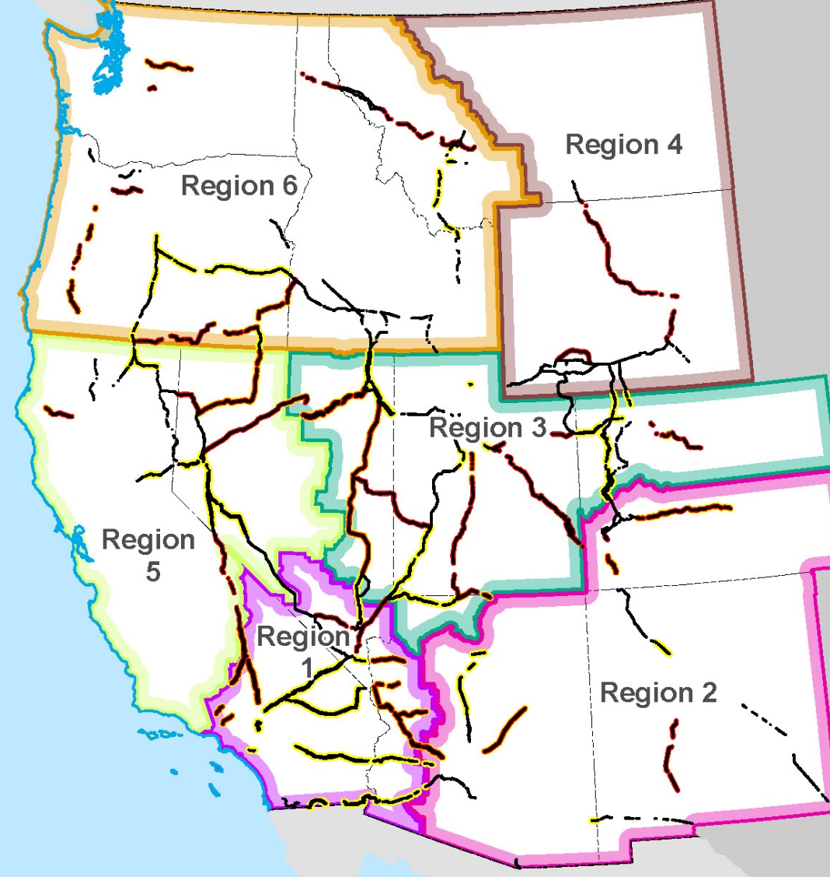
I. Environmental Data Sets: BLM
    Federal ROW Data:
  ROW Corridors, Avoidance and Exclusion Areas
  Existing BLM EDWG-collected ROW Data + New BLM/USFS Greater Sage-Grouse ROW Data
  Next Steps: Incorporate updates from Federal Service 368 Energy Corridors Review when available
Notes:
BLM right-of-way designation data. This consists of BLM right-of-way corridors (category 1); BLM right-of-way avoidance areas (category 3); and BLM right-of-way exclusion ar
BLM Sage-Grouse Management Areas
NV, neCA – ROD data available online and acquired.
nwCO – ROD data available online and acquired.
ID, swMT – ROD data available online and acquired.
MT (Lewistown) – ROD data available online and acquired.
MT (Billings/Pompey Pillar NM) – ROD data not available online.
MT (HiLine) – ROD data not available online.
MT (Miles City) – ROD data not available online.
OR – FEIS data available online and acquired. Need to confirm with BLM that no changes were made for the ROD or request official ROD data.
UT – ROD data available online and acquired.
WY – FEIS data available online for Bighorn, Buffalo, and 9-Plan. Need to confirm with BLM that no changes were made for the ROD or request official ROD data.
eas (category 4).

Slide 20
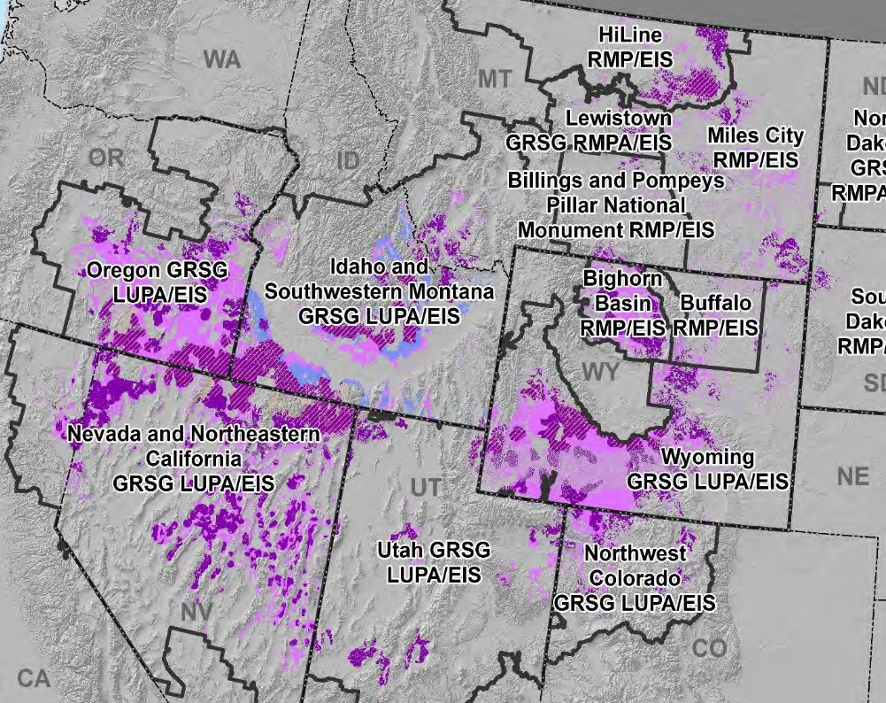
II. Environmental Data Sets: BLM
Greater Sage-Grouse:
  2015 BLM and US Forest Service Land Use Plans
  Next Steps: Discussion with BLM/USFS/State FW
    Is General/Priority Habitat data needed in EDWG Risk Layer? Only on non-federal lands?
    How should EDWG consider individual state Sage-Grouse Conservation Plans?
Notes:
BLM right-of-way designation data. This consists of BLM right-of-way corridors (category 1); BLM right-of-way avoidance areas (category 3); and BLM right-of-way exclusion ar
BLM Sage-Grouse Management Areas
NV, neCA – ROD data available online and acquired.
nwCO – ROD data available online and acquired.
ID, swMT – ROD data available online and acquired.
MT (Lewistown) – ROD data available online and acquired.
MT (Billings/Pompey Pillar NM) – ROD data not available online.
MT (HiLine) – ROD data not available online.
MT (Miles City) – ROD data not available online.
OR – FEIS data available online and acquired. Need to confirm with BLM that no changes were made for the ROD or request official ROD data.
UT – ROD data available online and acquired.
WY – FEIS data available online for Bighorn, Buffalo, and 9-Plan. Need to confirm with BLM that no changes were made for the ROD or request official ROD data.
eas (category 4).

Slide 21
III. Environmental Data Set Update: Canada
New Stakeholder Recommendations for Alberta
Resource Issue | Restriction | Potential Risk Category
Grizzly Bear Zone | Only parallel existing lines | Cat 3? Cat 4 + Cat 1 override?
Caribou Range | Only parallel existing lines | Cat 3? Cat 4 + Cat 1 override?
Mountain Goat and Sheep Areas | Only parallel existing lines | Cat 3? Cat 4 + Cat 1 override?
Trumpeter Swan habitat | Burial required in certain locations | Cat 3?
Greater Sage Grouse | Under an Emergency Order of Protection | Cat 4?

Slide 22
III. Environmental Data Set Update: Canada
Other Potential New Data for Alberta
Resource Issue | Restriction? | Potential Risk Category
SARA Listed Species Range Data | Varies by species | Cat 2? (Note: EDWG general does not use range data, only occurrence and critical habitat data)
Colonial Nesting Bird sites | Recommended for avoidance | Cat 2 or 3?
Special Access Zones (Natural habitat within an intensively developed landscapes) | None identified | Cat 2?

Slide 23
IV. Environmental Data Sets: NatureServe
State Heritage Program Data (NatureServe):
  Presence/Absence Data for G1-G2, G3, and U.S. ESA/SARA Species Across the Western North America
    G3 = EDWG Risk Category 2
    G1-G2 and U.S. ESA/Canadian SARA = EDWG Risk Category 3
  Next Step?: Update license agreement with NatureServe
Notes:
Species of Concern: Species of state and/or national conservation importance, including those vulnerable to extinction or those undergoing regional decline or other species requiring special management attention. Most states defined their Species of Concern list using State Wildlife Action Plan "Species of Greatest Conservation Need" and NatureServe conservation status rankings, and other criteria in some cases. Individual species are not depicted but the resources section of this site contains information specific to the Greater Sage Grouse and the Lesser Prairie Chicken.
Terrestrial Species of Concern: Species of state and/or national conservation importance that occur on land. May include birds, mammals, amphibians, reptiles, insects, plants and invertebrates.

Slide 24
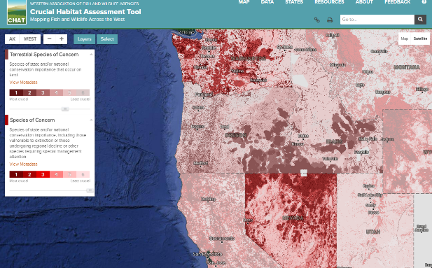
IV. Environmental Data Sets: NatureServe
  Option: Western Association of Fish and Wildlife Agencies CHAT data
  Crucial Habitat Rank CHAT layer not used in WECC Risk Layer
  Investigating Species of Concern/Terrestrial Species of Concern CHAT layers
Notes:
Species of Concern: Species of state and/or national conservation importance, including those vulnerable to extinction or those undergoing regional decline or other species requiring special management attention. Most states defined their Species of Concern list using State Wildlife Action Plan "Species of Greatest Conservation Need" and NatureServe conservation status rankings, and other criteria in some cases. Individual species are not depicted but the resources section of this site contains information specific to the Greater Sage Grouse and the Lesser Prairie Chicken.
Terrestrial Species of Concern: Species of state and/or national conservation importance that occur on land. May include birds, mammals, amphibians, reptiles, insects, plants and invertebrates.

Slide 25
IV. Environmental Data Sets: NatureServe
  Option: Western Association of Fish and Wildlife Agencies CHAT data
  Benefits
    Includes species of state and/or national conservation importance (vulnerable to extinction, undergoing regional decline, or requiring special management attention)
    Includes ESA/G1-G3 Species Occurrence, but also other items (e.g., Core Sage-Grouse Habitat)
    Free and up-to-date
  Drawbacks
    Not 100% consistent state-to-state
    No real correlation with existing NatureServe Data
    U.S. only

Slide 26
Supporting Slides

Slide 27
EDWG Survey: Participant type
 | Response Percent | Response Count
I am a project proponent who plans the development of new facilities that are built and maintained by my organization. | 7.1% | 1
I am affiliated with a public regulatory or review agency that reviews, licenses, or permits proposed transmission facilities. | 35.7% | 5
I am affiliated with a non-governmental organization that provides input on proposed transmission facilities. | 14.3% | 2
I am affiliated with a non-governmental organization involved in renewable energy issues. | 7.7% | 1
I am a consultant involved in planning or assessment of transmission facilities on behalf of public or private clients. | 14.3% | 2
Other | 21.4% | 3 (1)

Slide 28
EDWG Survey: Review of Current Features
How important to you is the following EXISTING functionality?
Potential Data | Rating Average
Give unique names to any transmission corridor(s) you draw | 4.50
Draw and download a transmission line | 4.36
Create a database file that contains the length and attributes (risk classes, area types, mitigation and capital costs) of each segment | 4.00
Report and graph of the capital cost and environmental mitigation cost estimate | 4.00
Report and graph showing the mileage of each Environmental Risk Category crossed | 3.91
1 Low Importance/ Highly Important

