Slide 1
Environmental and Cultural Data Products
Environmental Data Work Group
April 8, 2016
Nathan Wagoner, ICF
Dan Moreno, ICF

Slide 2
Presentation Overview
  Data Viewer
  Cultural Data Viewer: Demo and Next Steps
  Testing and Stakeholder Review
  Environmental Data Set Update
  Overview of update and QA process
  Changes to Preferred Data Layers

Slide 3
Cultural Data Viewer

Slide 4
Cultural Data Viewer
Internal Draft Cultural Data Viewer
  EDWG Planning Team Demo on March 2
  Nevada SHPO presented to National Conference of SHPOs
Recent Revisions based on comments:
  Disclaimer language enhanced
  SHPO contacts added
  Hyperlinks added
  Map colors/symbology clarified

Slide 5
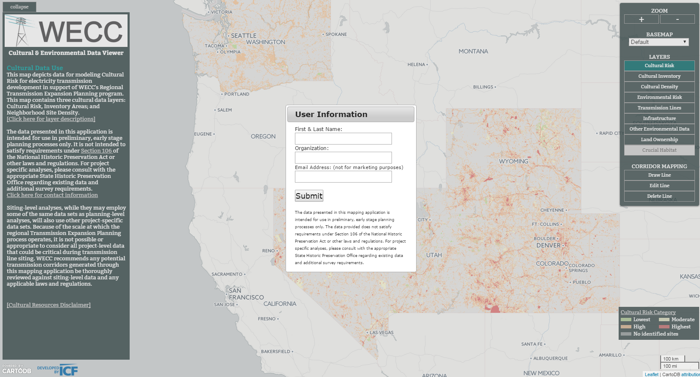
Cultural Data Viewer
Demo of revised version

Slide 6
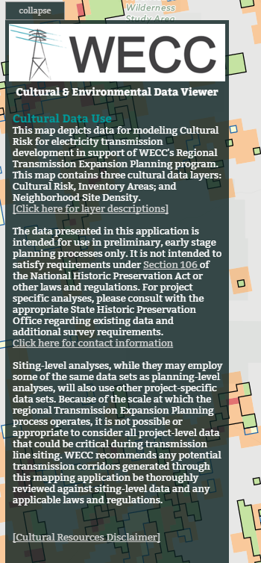
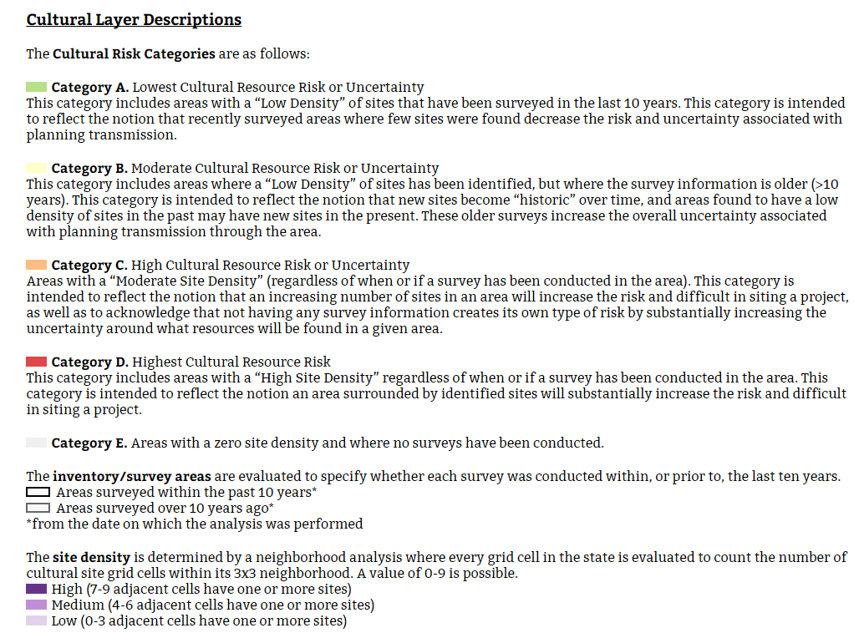
Cultural Data Viewer

Slide 7
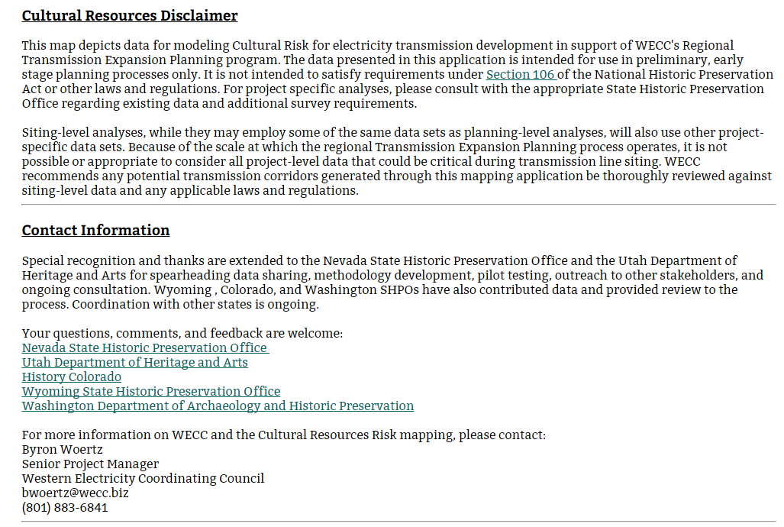
Cultural Data Viewer

Slide 8
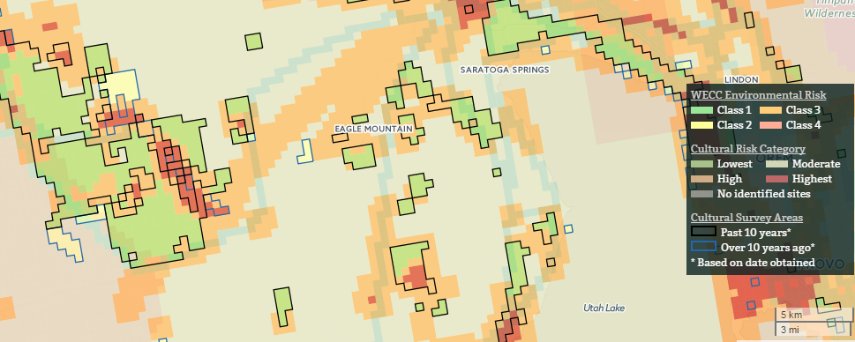
Cultural Data Viewer

Slide 9
Cultural Data Viewer – Next Steps
Formal review by participating SHPOs – April to May
Seek SHPO approval to publish – May
  Revise the Cultural Data Sharing Agreement description to specify final version of Cultural Data Viewer
Publish to the WECC Website – May/June
  User registration required to enhance accountability

Slide 10
Cultural Data Viewer – Next Steps (cont)
Update existing and add new cultural data as available
  Anticipate Arizona approval end of April!
  Work with EDWG members on outreach to remaining states
  Oregon and Idaho
  California (partner with RETI?)

Slide 11
Environmental Data Work Group Stakeholder Input Survey and Beta Test

Slide 12
Beta Test
Drafts of the Beta Test and Guide Released May 16
  Testing the new CartoDB version of the Data Viewer
  Validating it functions as designed for all users
  Next Steps: Approve Beta Test and Guide and supply link to participants
Deadline for completion – May 2016

Slide 13
EDWG Stakeholder Input Survey
Drafts of the Survey Released April 16
  Users review and provide suggestions for improving the CartoDB Data Viewer
  14 responses received to date
  Overview of preliminary results available
  Next Steps: Approve survey and request additional participants
  Deadline for completion – May 2016

Slide 14
EDWG Survey: Participant type
 | Response Percent | Response Count
I am a project proponent who plans the development of new facilities that are built and maintained by my organization. | 7.7% | 1
I am affiliated with a public regulatory or review agency that reviews, licenses, or permits proposed transmission facilities. | 30.8% | 4
I am affiliated with a non-governmental organization that provides input on proposed transmission facilities. | 15.4% | 2
I am affiliated with a non-governmental organization involved in renewable energy issues. | 7.7% | 1
I am a consultant involved in planning or assessment of transmission facilities on behalf of public or private clients. | 15.4% | 2
Other | 23.1% | 3

Slide 15
EDWG Survey: Additional Data Layers
Which additional map data layers would be most useful to you in performing your work?
Potential Data | Rating Average
Cultural (e.g., archaeological and historic) resources | 3.82
Visual resources or visual sensitivity | 4.00
Census/demographics | 2.20
Federal or state agency existing right-of-way agreements and easements | 2.73
Raptor habitat and nest locations | 2.91
1 Low Importance/ 5 Highly Important

Slide 16
EDWG Survey: Additional Requested Layers
Slope/Topography
Existing energy infrastructure (e.g., pipelines, well pads)
Greater Sage-Grouse Priority/General habitat and leks
Viewshed issues (sensitive viewsheds such as parks and scenic areas)
Preserves
Population density data (not census data)
Land Ownership
Archaeological sensitivity zones (Predictive Modeling)
Crucial wildlife habitat data (State Fish and Wildlife)
Designated endangered species critical habitat
Restricted areas due to FAA (beyond DOD lands)
Military test and training areas
Airports

Slide 17
EDWG Survey: Review of Current Features
How important to you is the following EXISTING functionality?
Potential Data | Rating Average
Draw and download a transmission line | 4.30
Give unique names to any transmission corridor(s) you draw | 4.00
Report and graph showing the mileage of each Environmental Risk Category crossed | 3.91
Report and graph of the capital cost and environmental mitigation cost estimate | 3.80
Create a database file that contains the length and attributes (risk classes, area types, mitigation and capital costs) of each segment | 4.00
1 Low Importance/ Highly Important

Slide 18
EDWG Survey: Desire for New Features
How important to you is the following NEW POTENTIAL functionality?
Potential Data | Rating Average
Upload my organization's transmission line data and have them appear in the online map. | 3.64
Upload other data layers (e.g., survey locations, energy facilities) and have them appear in the online map. | 3.73
Pick two end points and have the system draw (optimize for) the lowest environmental risk route. | 4.00
Pick two end points and have the system draw (optimize for) the least capital (or mitigation cost) route. | 4.00
Change voltage type and class (AC/DC) against which capital cost is calculated. | 4.36
Add Cultural Risk Map to the online Data Viewer | 5.00
1 Low Importance/ 5 Highly Important

Slide 19
Environmental Data Set Update

Slide 20
Environmental Data Set Update
  Objectives:
  Identify and obtain any updates or additions to the Preferred Data Sets that contribute to the calculation of environmental risk class (1-4).
  Apply these new data sets to the calculation of updated risk classes (update and run the models).
  Publish the updated risk classes.
    Downloadable shapefile
    Environmental and Cultural Data Viewers

Slide 21
Environmental Data Set Update
  Methods
  completed:
Check the source of each Preferred Data Set
  2. Where needed, download and view the data to identify if changes occurred
  Download and log each updated data set; run Data Quality Protocol to assess fitness-for-use

Slide 22
Environmental Data Set Update
  Methods (cont)
  to do:
  **Coordinate with agencies, EDWG, and other data providers on any changes to data or data interpretation
  EDWG approve final data and data interpretation approach
  Revise and run the GIS models to calculate new risk classes
  Publish new risk class layer to Environmental Data Viewer and Cultural/Environmental Data Viewer
  Publish new risk class layer to WECC’s download page
  Advise user community of update

Slide 23
Environmental Data Set Update
Check the source of each Preferred Data Set
Item | Count
Preferred Data Sets checked | 106
Download data to identify if changes occurred
Item | Count
Preferred Data Sets updated | 48
Area Types currently affected | 28 (out of 88)
Note: A Preferred Data Set may be comprised of one or more data files.

Slide 24
Environmental Data Set Update
  Download and log each updated data set
Most Significant Area Type Updates
Area Type | Count of Data Sets Updated
State Mapped Crucial Big Game Winter Range/Severe Winter Range | 15
Greater Sage-Grouse Preliminary General Habitats | 9
Greater Sage-Grouse Preliminary Priority Habitats | 9
Areas that contain ecosystems or species that are at moderate risk | 9
Scenic Highway, Scenic Byways, and All-American Roads | 5

Slide 25
Environmental Data Sets: NatureServe
Coordinate on changes to data or data interpretation
State Heritage Program Data (NatureServe):
  Presence/Absence Data for G1-G2, G3, and U.S. ESA/SARA Species Across the Western North America
    G3 = EDWG Risk Category 2
    G1-G2 and U.S. ESA/Canadian SARA = EDWG Risk Category 3
  Would require WECC update license agreement with NatureServe.
Landscape Conditions Data (NatureServe):
  Received directly from NatureServe
  Informs EDWG Risk Category 2

Slide 26
Environmental Data Sets: BLM
Coordinate on changes to data or data interpretation (cont)
Greater Sage-Grouse Data:
  Updated for 2015 Record of Decision Data where available
  Coordinate interpretation of layers with BLM/Forest Service
    General Habitat = remain EDWG Risk Category 2?
    Priority Habitat = remain EDWG Risk Category 3?
    Restoration/Important Habitat Management Areas?
    Major vs Minor ROWs?
    Federal vs Non-federal lands?
    BLM ROW Data:
  Past coordination efforts
  Additional data available or changes to approach due to Greater Sage-Grouse Record of Decision Data?
Notes:
BLM right-of-way designation data. This consists of BLM right-of-way corridors (category 1); BLM right-of-way avoidance areas (category 3); and BLM right-of-way exclusion ar
BLM Sage-Grouse Management Areas
NV, neCA – ROD data available online and acquired.
nwCO – ROD data available online and acquired.
ID, swMT – ROD data available online and acquired.
MT (Lewistown) – ROD data available online and acquired.
MT (Billings/Pompey Pillar NM) – ROD data not available online.
MT (HiLine) – ROD data not available online.
MT (Miles City) – ROD data not available online.
OR – FEIS data available online and acquired. Need to confirm with BLM that no changes were made for the ROD or request official ROD data.
UT – ROD data available online and acquired.
WY – FEIS data available online for Bighorn, Buffalo, and 9-Plan. Need to confirm with BLM that no changes were made for the ROD or request official ROD data.
eas (category 4).

Slide 27
Environmental Data Sets: State Agencies
Coordinate on changes to data or data interpretation (cont)
State Fish and Wildlife Agency Data:
  Reviewed previous Preferred Data
    Some data no longer available (e.g., Montana Forest Carnivores, Nevada Wetland Data)
  During Past Data Updates, WECC coordinated with each State Agency on changes or additions to Preferred Data
Notes:
EDWG previously reached out to each State Game and Fish Departments to acquire their newest wildlife habitat data; the risk classifications for this new data was be based on the recommendations from each state. Same process in 2016?

