Slide 1
March 25, 2024
WECC Enforcement Fundamentals:
Noncompliance Reporting
WECC Enforcement Staff

Slide 2




Enforcement Handling
Registered Entity
Regional Entity
NERC
FERC
Notes:
NERC is a non-profit regulatory body that focuses on ensuring the reliability and security of the bulk power system, while FERC is a government agency that regulates the interstate transmission of electricity and other energy commodities, as well as hydroelectric projects. Both organizations play a vital role in the electric power industry and work together to ensure the safe and reliable operation of the electric grid.

Slide 3




WECC Enforcement Training
Enforcement Background
Introduction
Noncompliance Reporting
Noncompliance Processing
Enforcement Review
Practice & References
Practice Cases
Job Aids
References
Building a Complete Story
Enforcement Function
Magnificent Seven
Enforcement Processing
Self-Logging Program
Description of Noncompliance
Extent of Condition
Duration
Risk to BES
Root Cause
Mitigation
Compliance History
Findings
Preliminary Screen
PNC Review
Enforcement
Disposition
Closing Case
Notes:
2.0 - ERO Self-Logging Program and Process
Describe how Self-Logging works to make it possible for Registered Entities to submit a detailed description of its minimal risk noncompliance and have it processed with little delay or handling from the Regional Entity.
What happens to a Self-Log after submitted. Include example of how the information is distilled from self-log to FERC.

Slide 4

Building a Complete Story
“Stories create community, enable us to see through the eyes of other people, and open us to the claims of others.”
– Peter Forbes
This Photo by Unknown Author is licensed under CC BY-ND

Slide 5

What goes into the story?
The Story
Plot
Characters
Point of View
Setting
Conflict

Slide 6
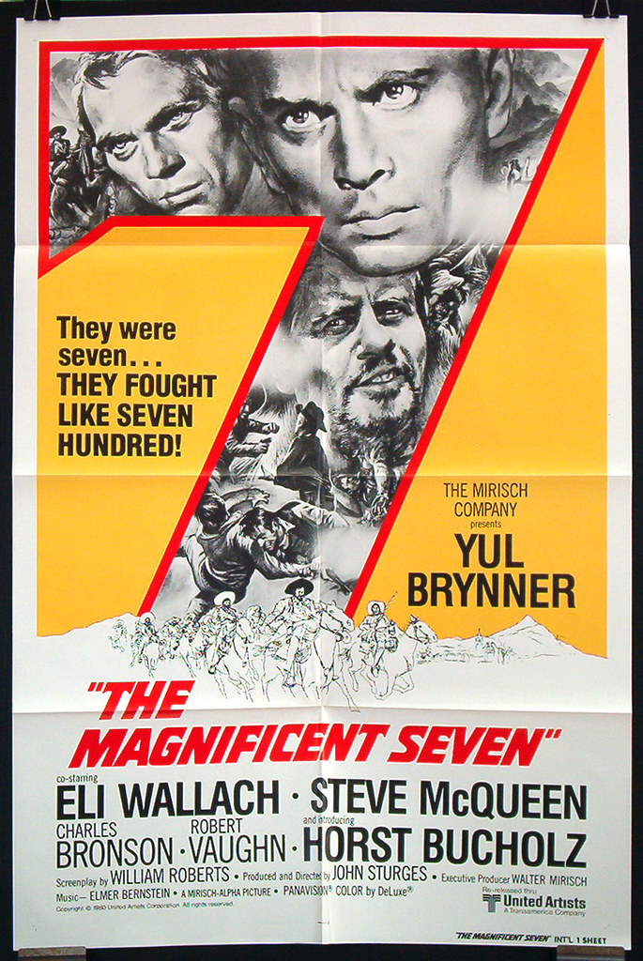




Magnificent Seven
The Story
Description
EOC
Duration
Root Cause
Risk
Mitigation
History
This Photo by Unknown Author is licensed under CC BY-SA-NC
This Photo by Unknown Author is licensed under CC BY-SA
Magnificent
This Photo by Unknown Author is licensed under CC BY-SA-NC
This Photo by Unknown Author is licensed under CC BY-NC-ND
Notes:
Perhaps many of you have seen the various version of the move Magnificent Seven. I won’t share too many details about the story…..other than to tell you it’s a classic and as such the story has been told many times. Whether the version you saw featured Samuries, Cowboys, or Vaquero – each movie really had the same characters.
For the record, Yul Brenner was likely the best, but I’ll recuse myself based on age.

Slide 7
Traditional Story Telling
The Story
Description
EOC
Duration
Root Cause
Risk
Mitigation
History
The Story
Plot
Characters
Point of View
Setting
Conflict

Slide 8

Registered Entity: Sunbear Power
CIP Standards | O&P Standards
CIP-004 | FAC-003
CIP-007 | VAR-002
Description of Noncompliance
Extent of Condition
Duration
Risk Analysis
Root Cause
Mitigation
Compliance History
The story, registered entity, and violations portrayed in this production are fictitious. No identification with actual registered entities or reported noncompliance is intended or should be inferred.

